Slide 1
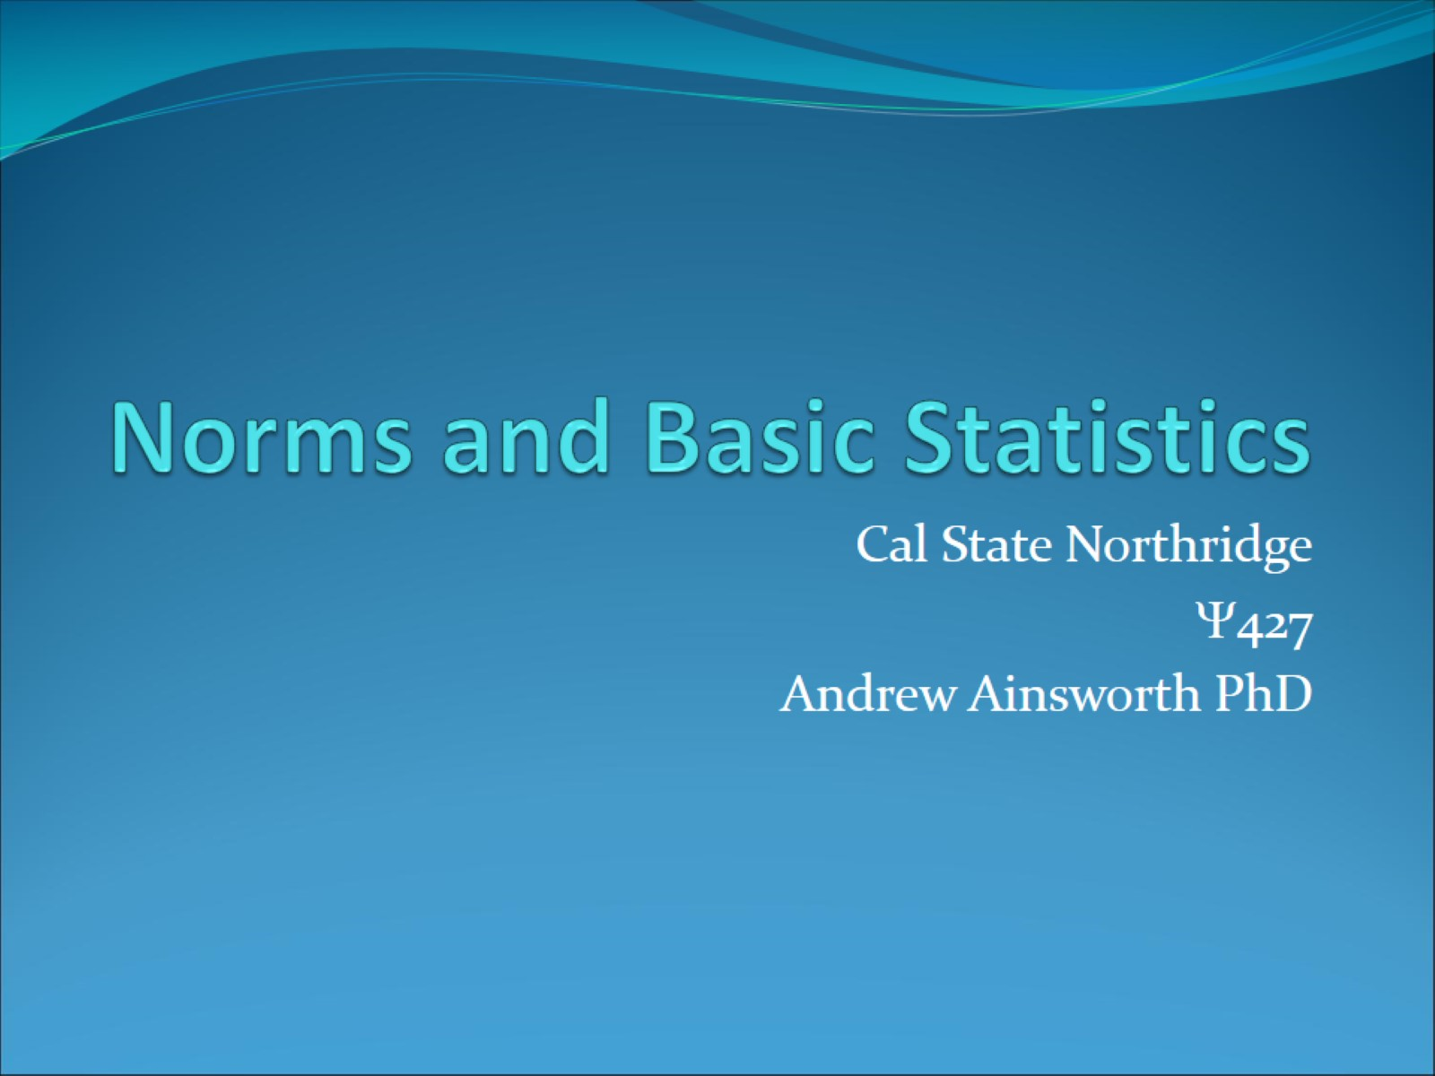
Norms and Basic Statistics

Slide 2
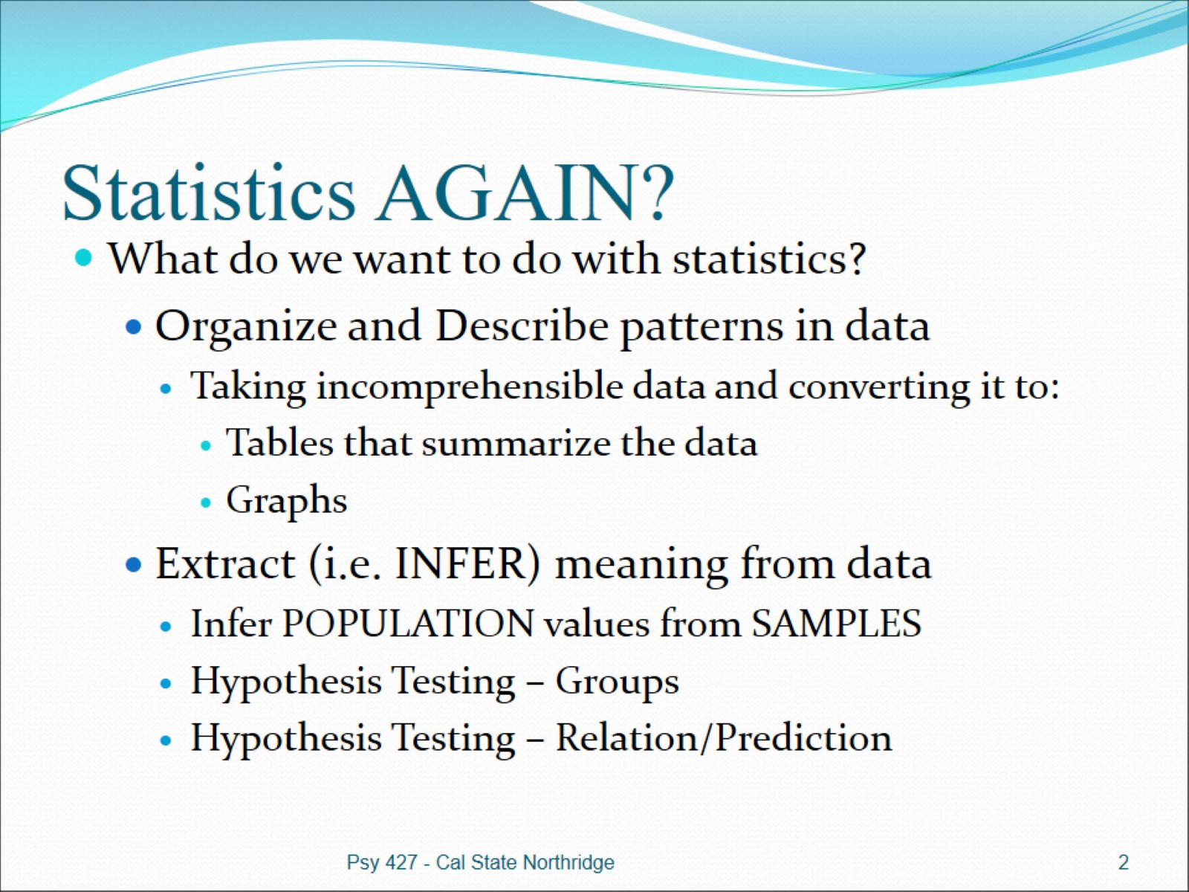
Statistics AGAIN?

Slide 3
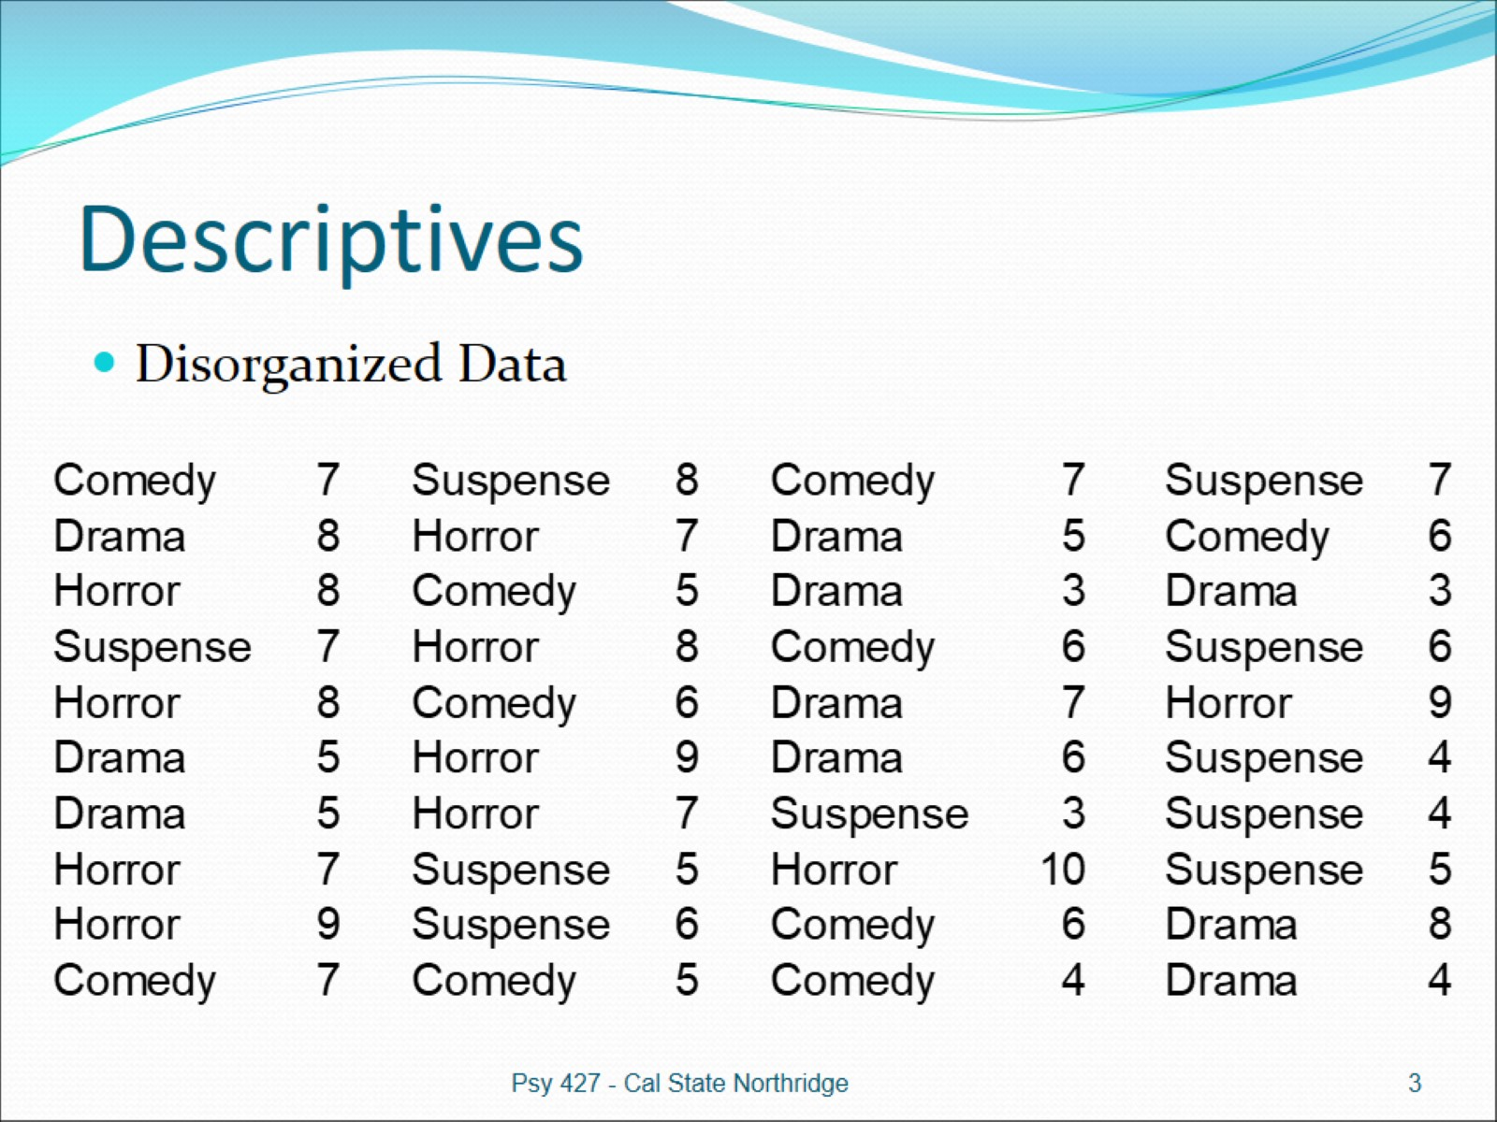
Descriptives

Slide 4
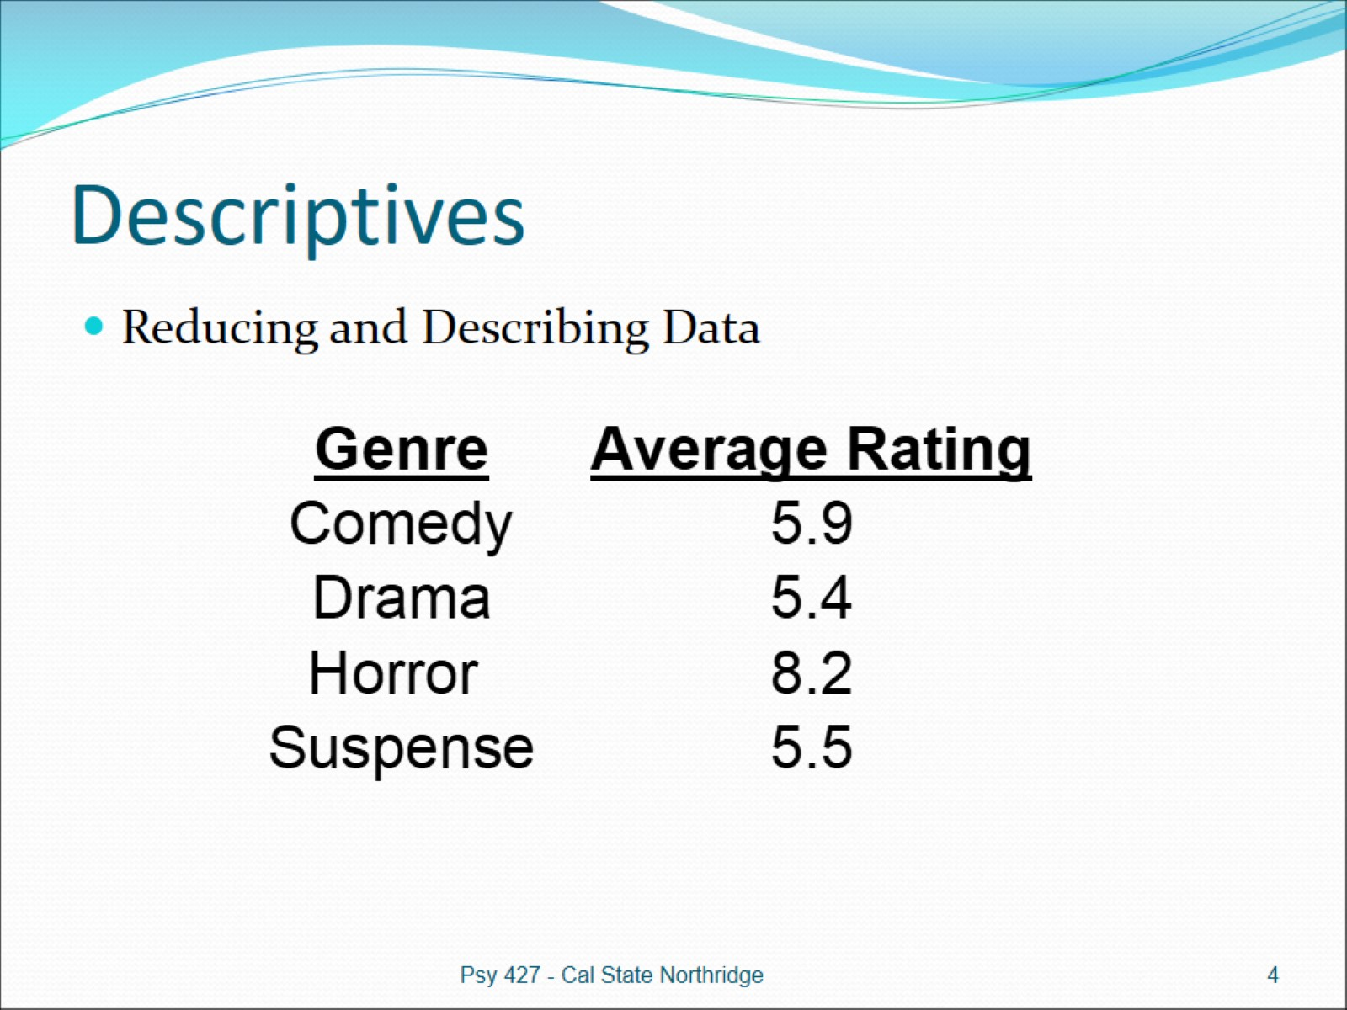
Descriptives

Slide 5
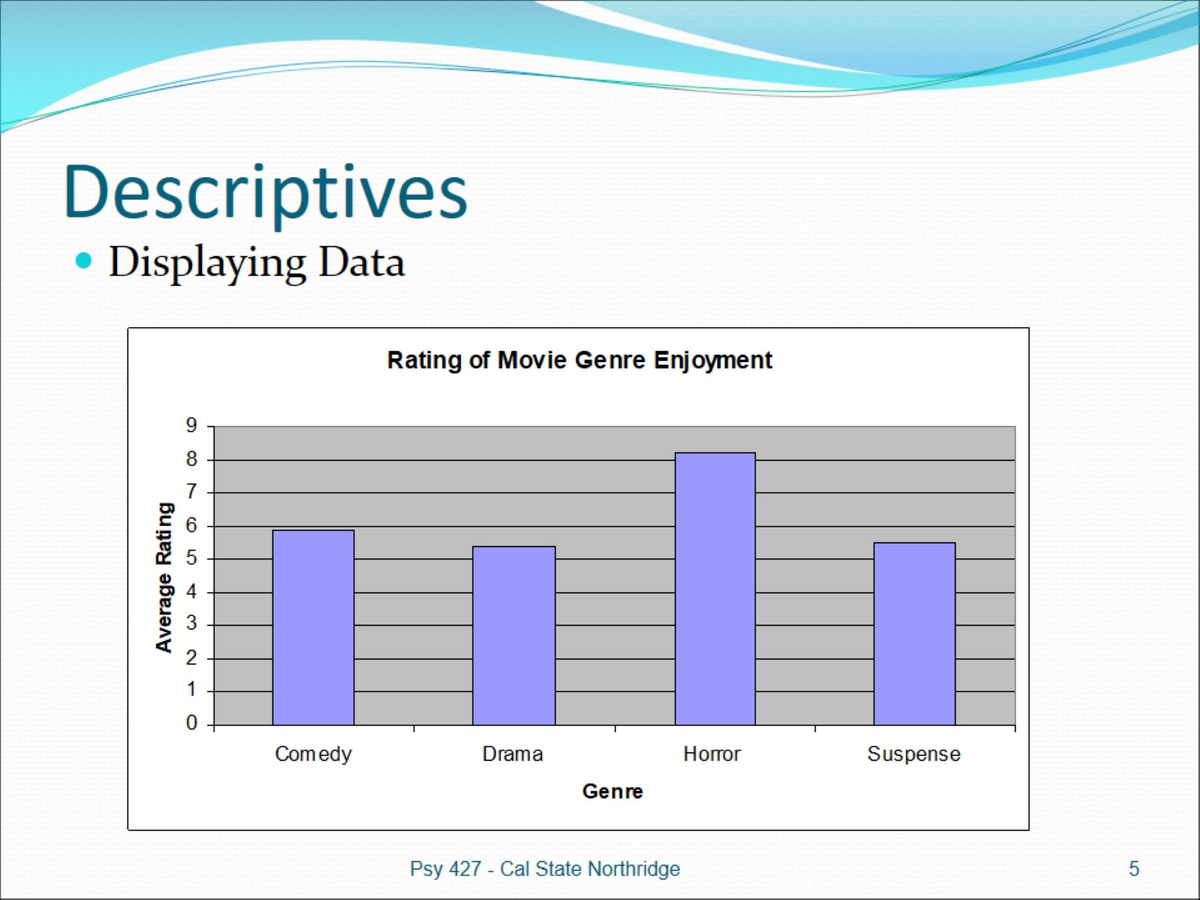
Descriptives

Slide 6
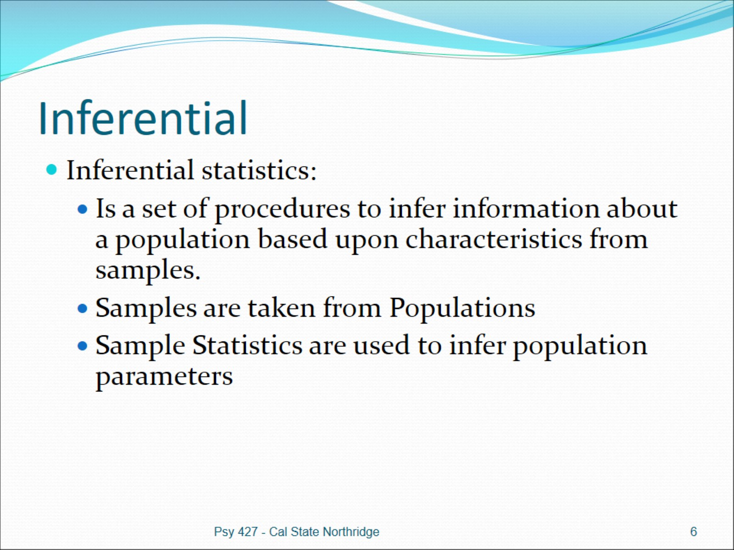
Inferential

Slide 7
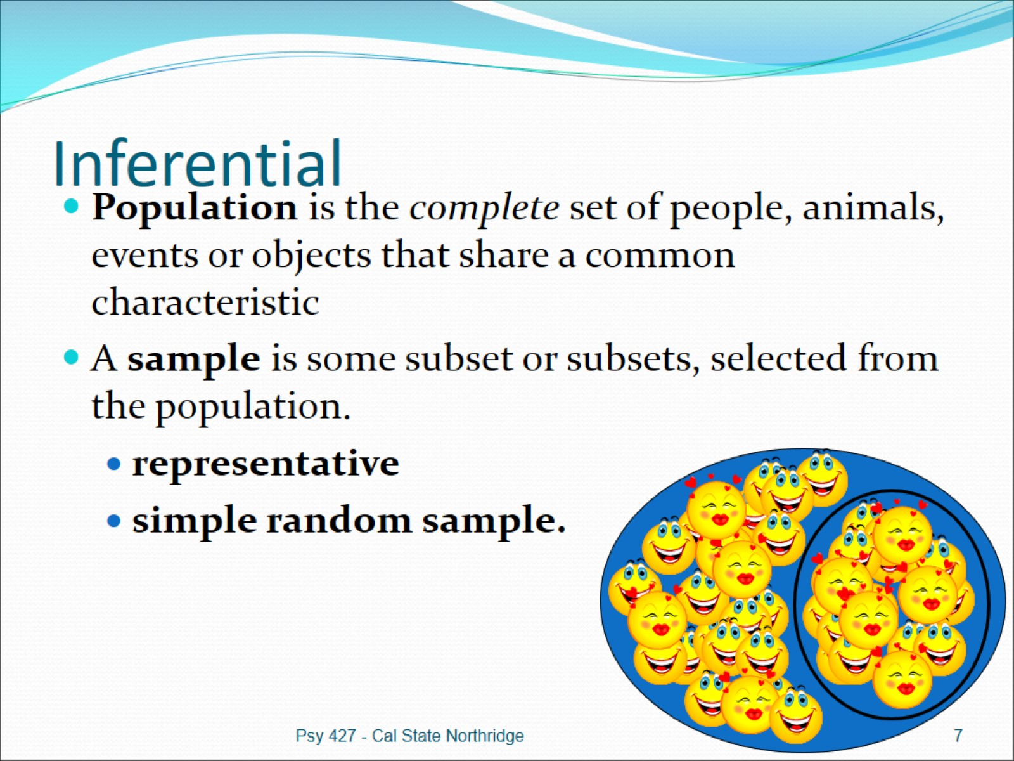
Inferential

Slide 8
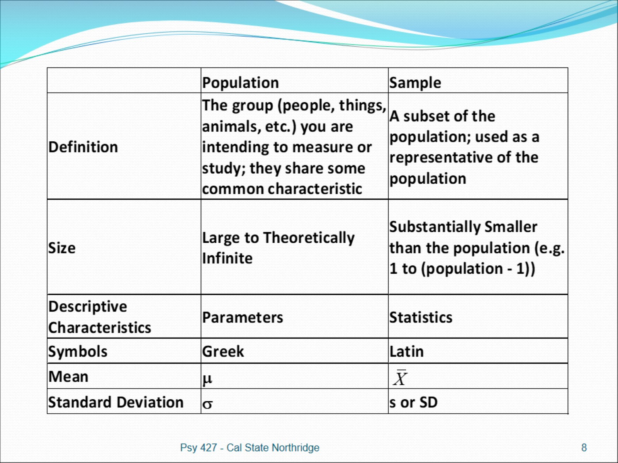

Slide 9
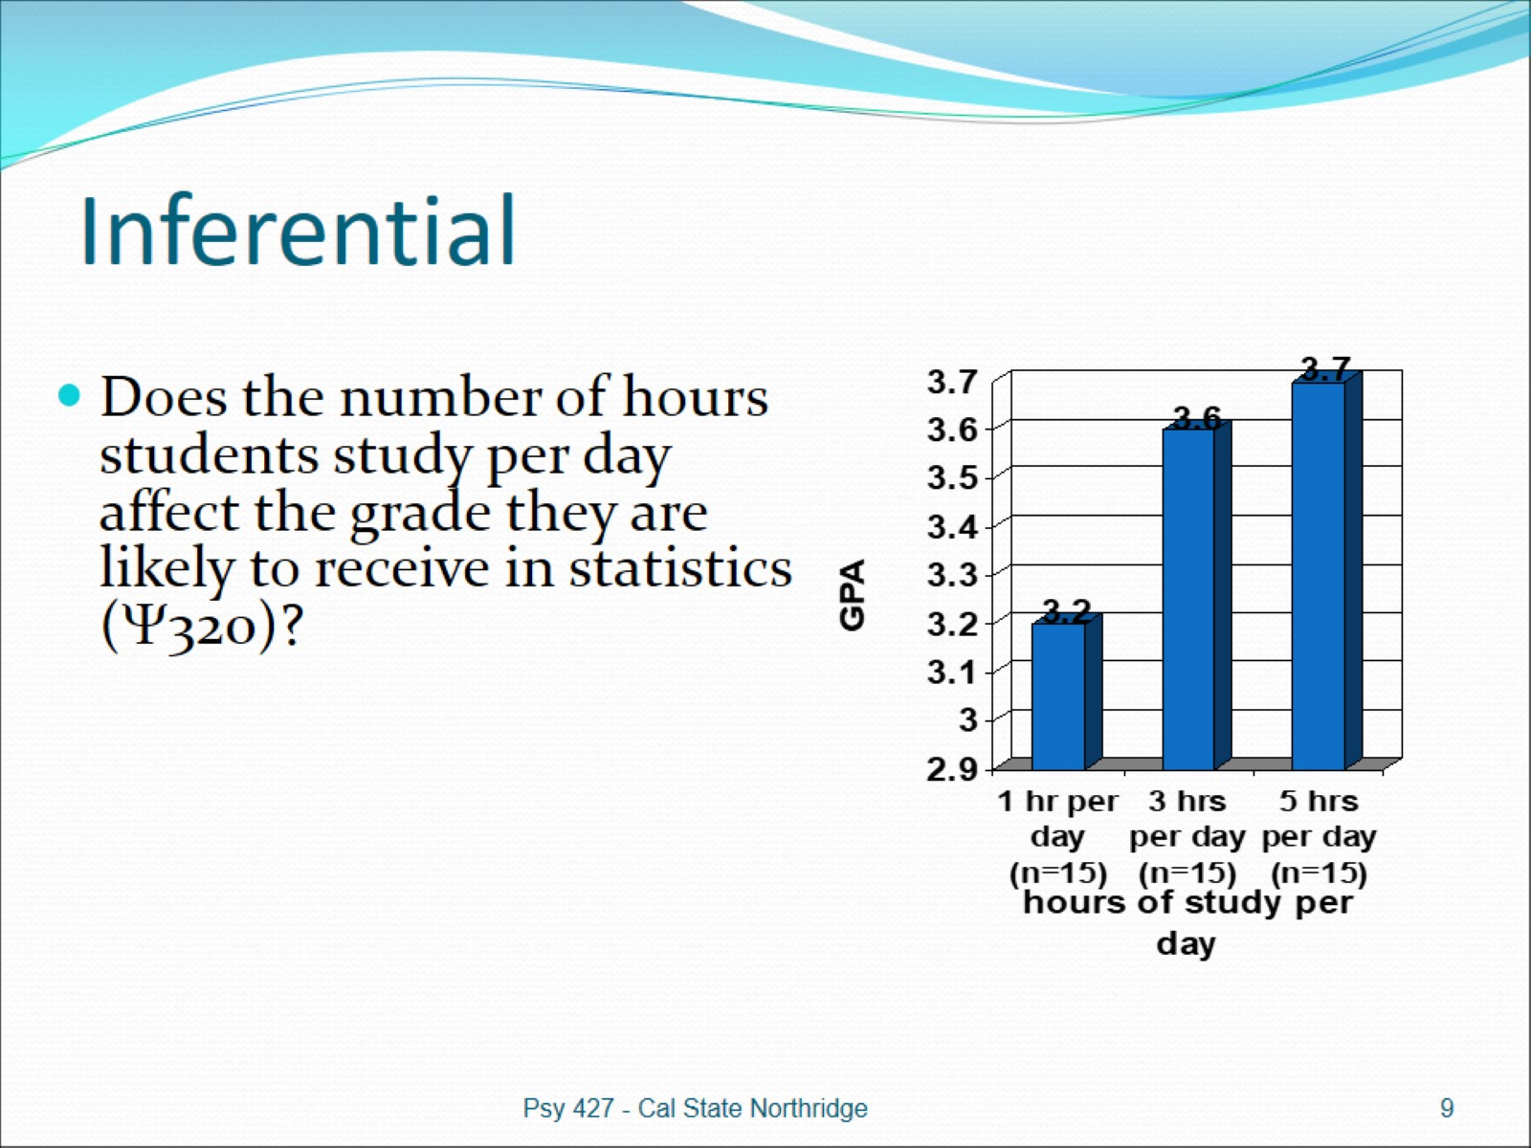
Inferential

Slide 10
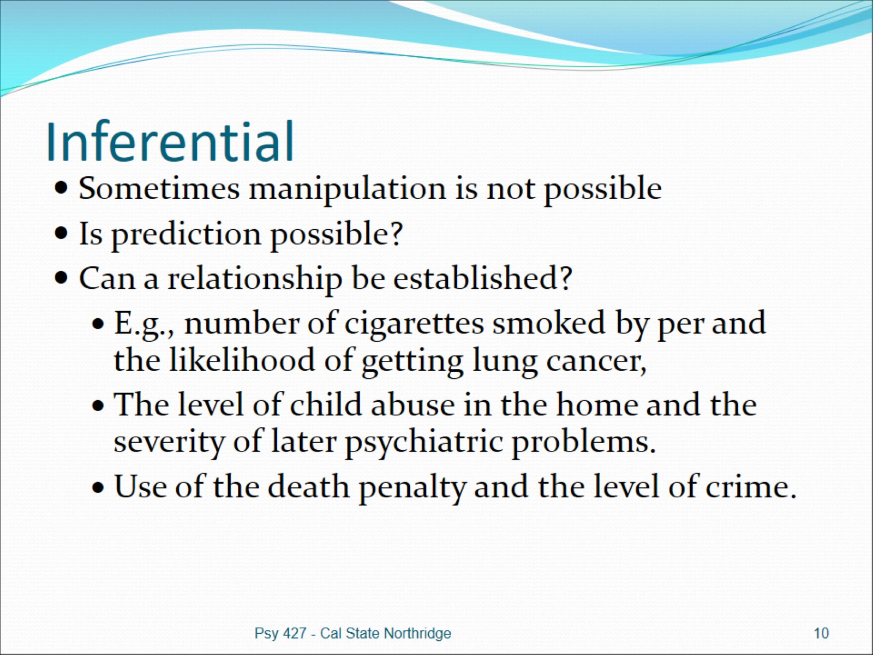
Inferential

Slide 11
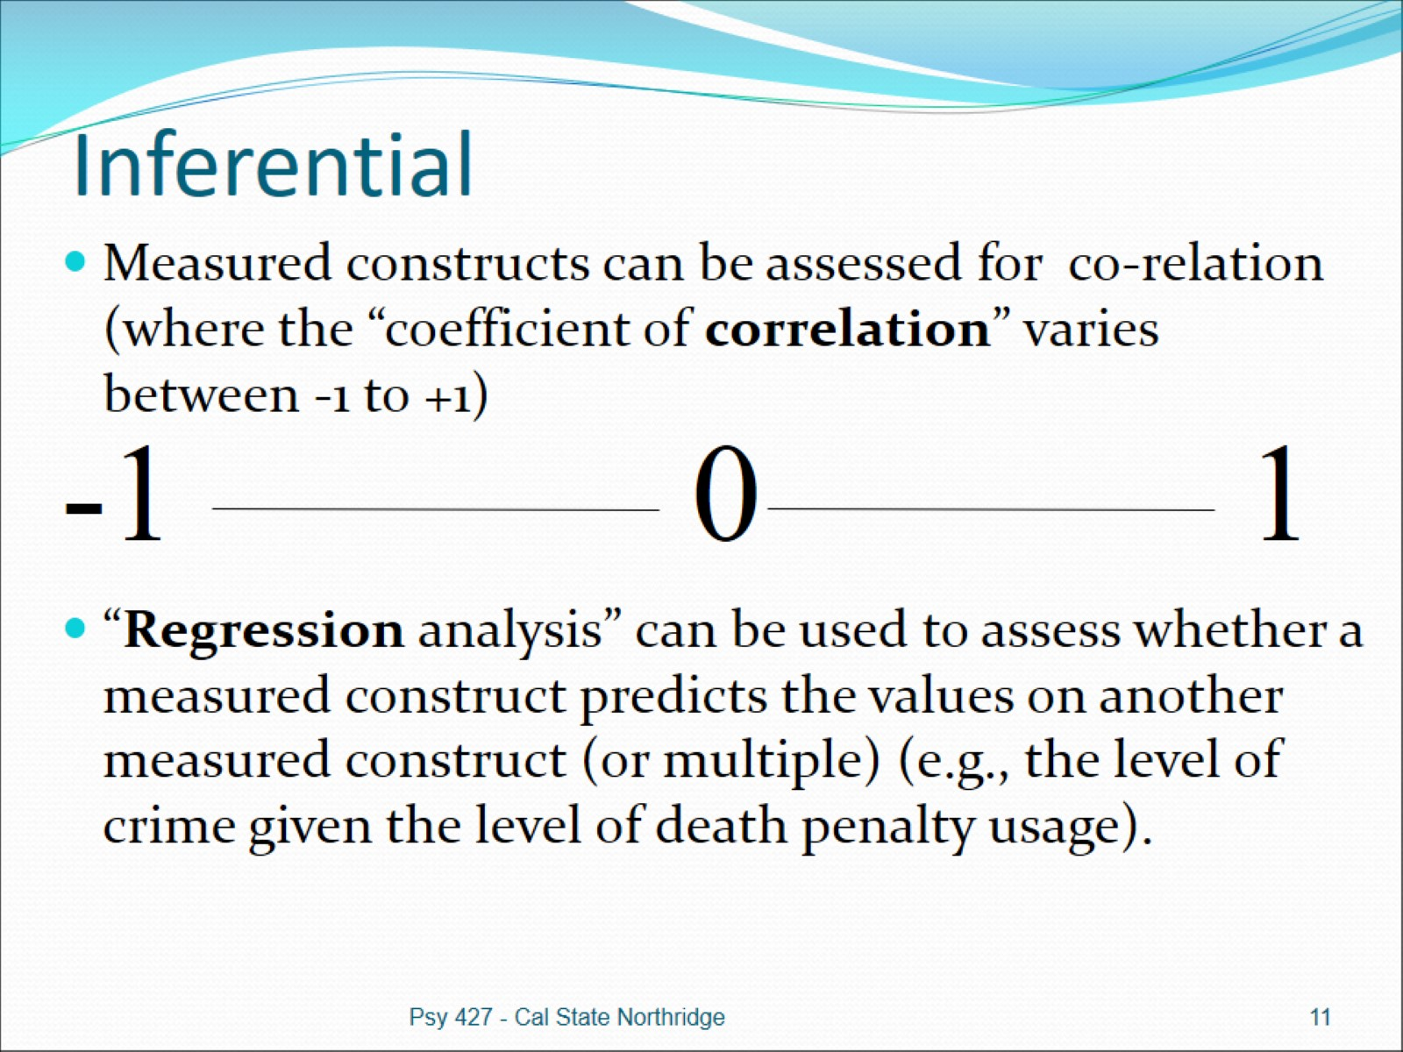
Inferential

Slide 12
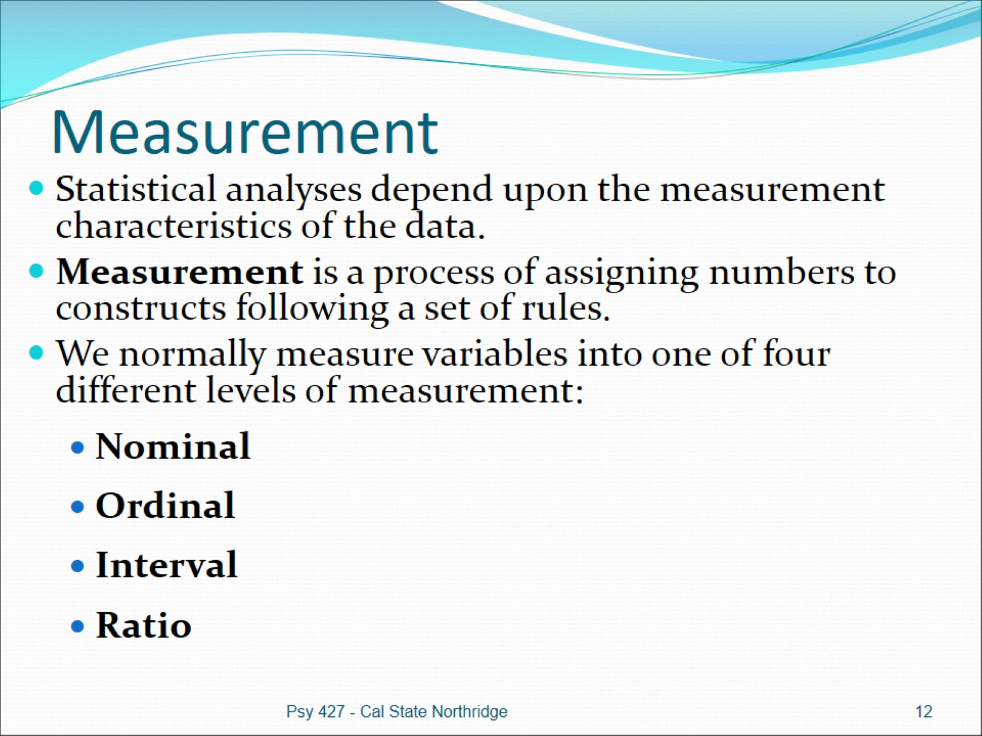
Measurement

Slide 13
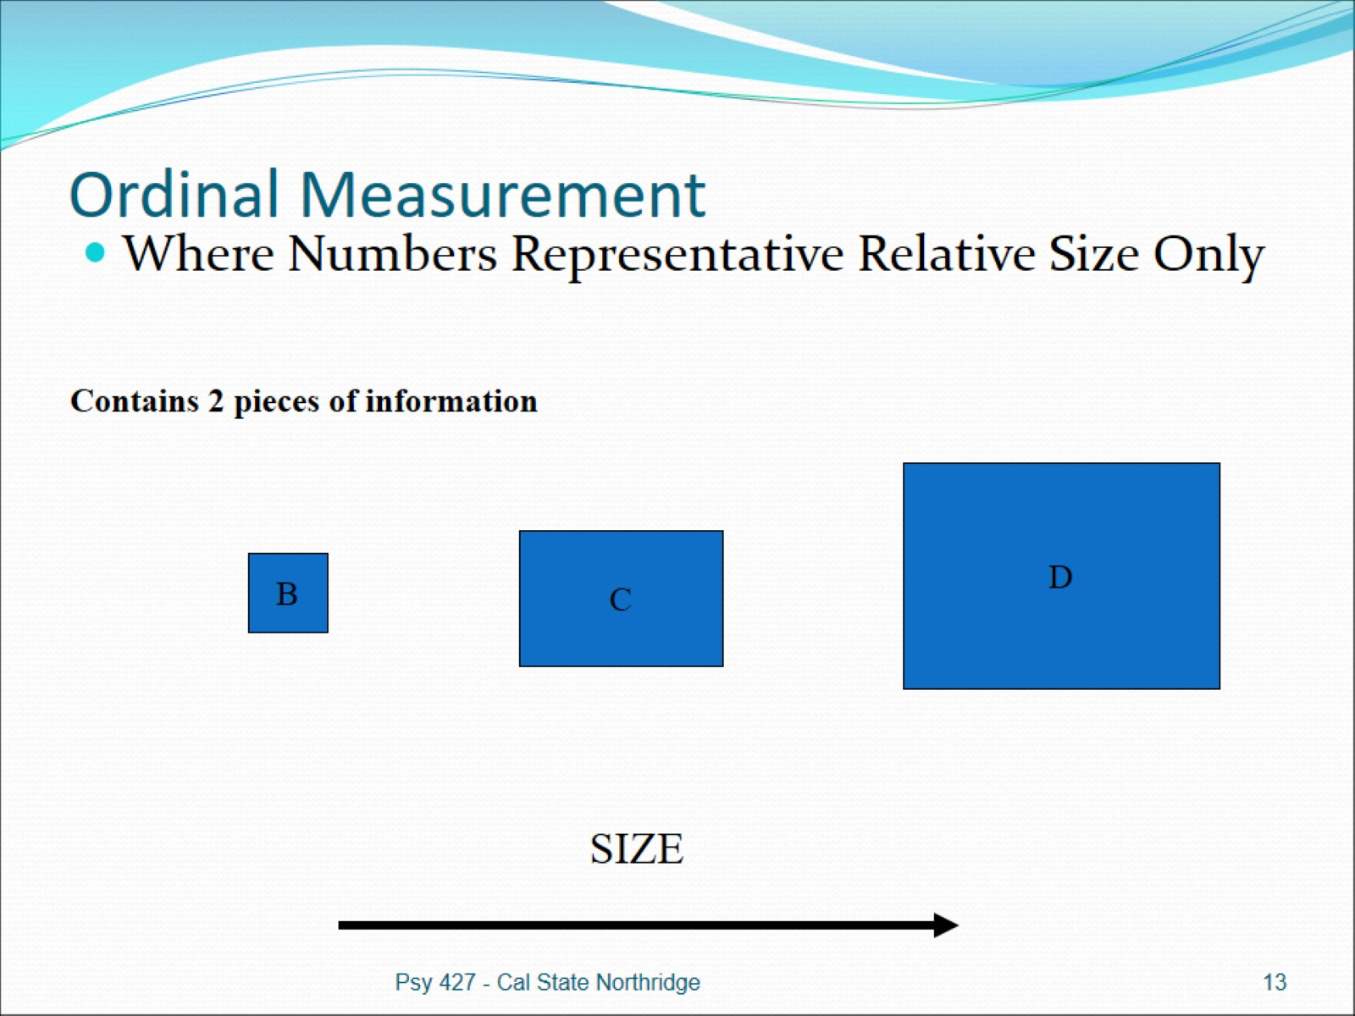
Ordinal Measurement

Slide 14
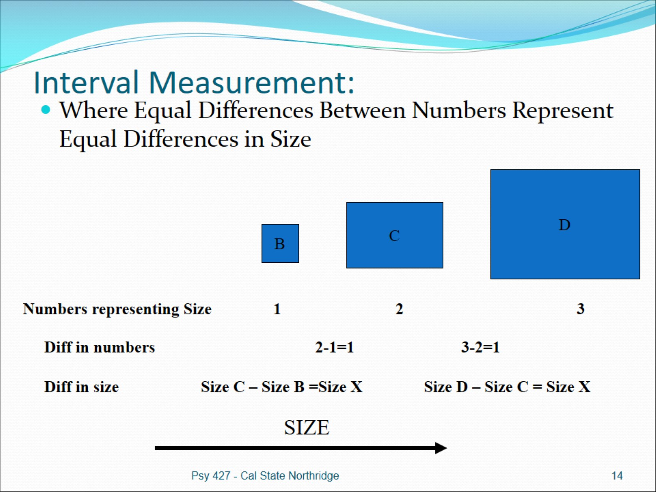
Interval Measurement:

Slide 15
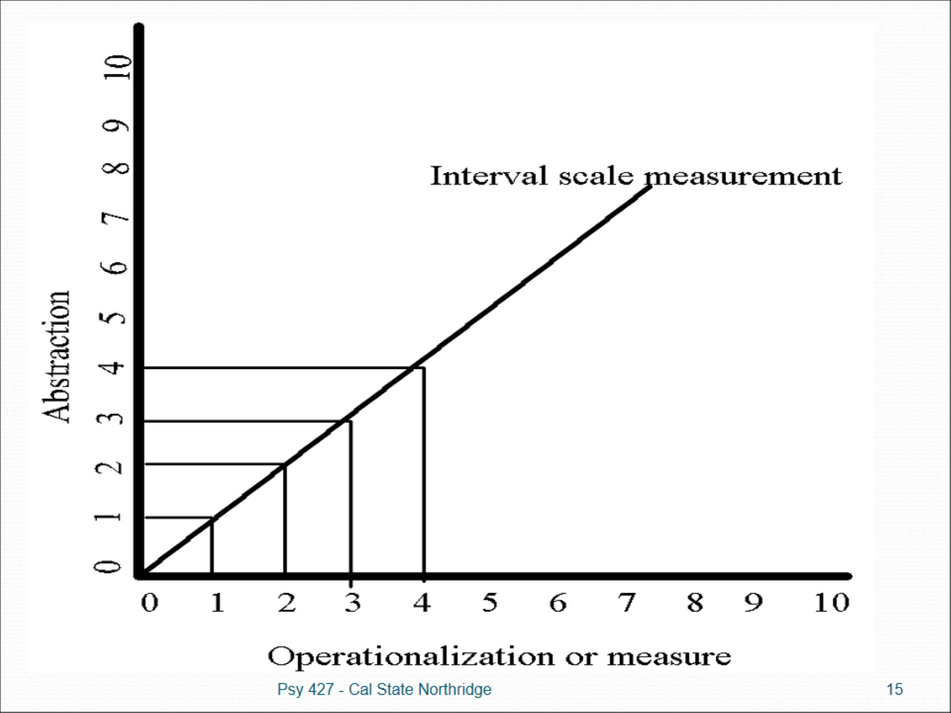

Slide 16
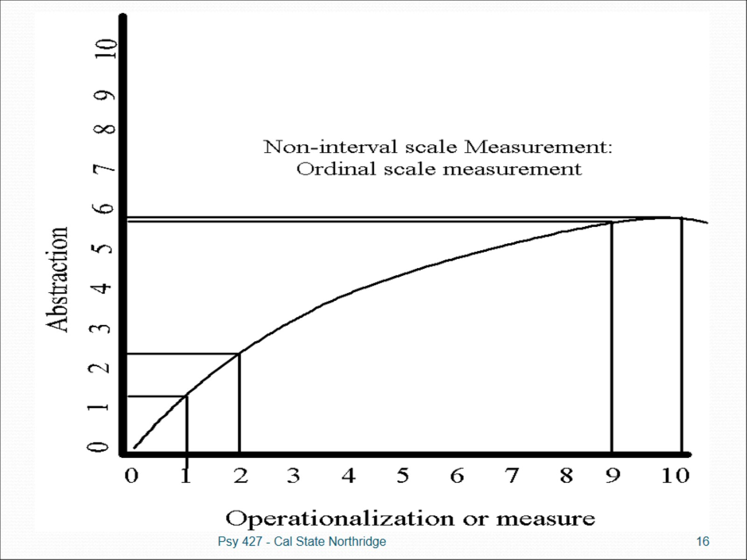

Slide 17
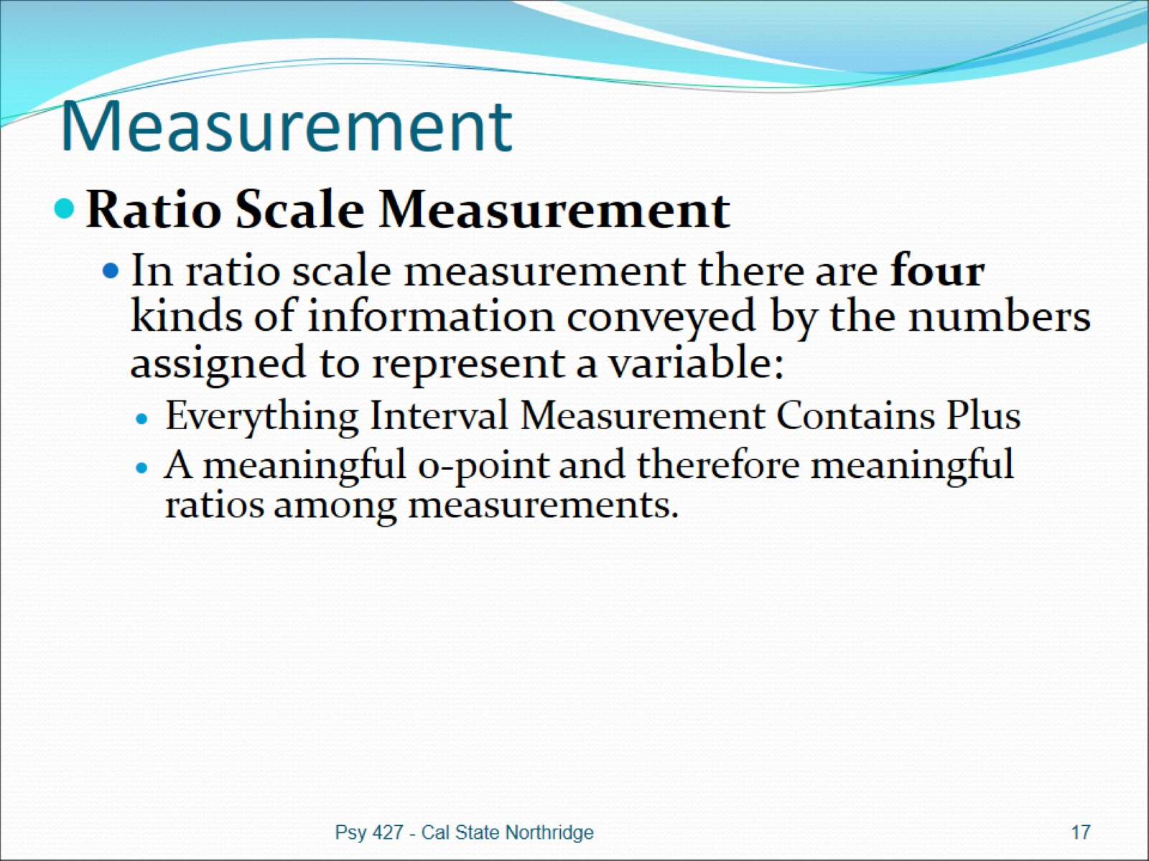
Measurement

Slide 18
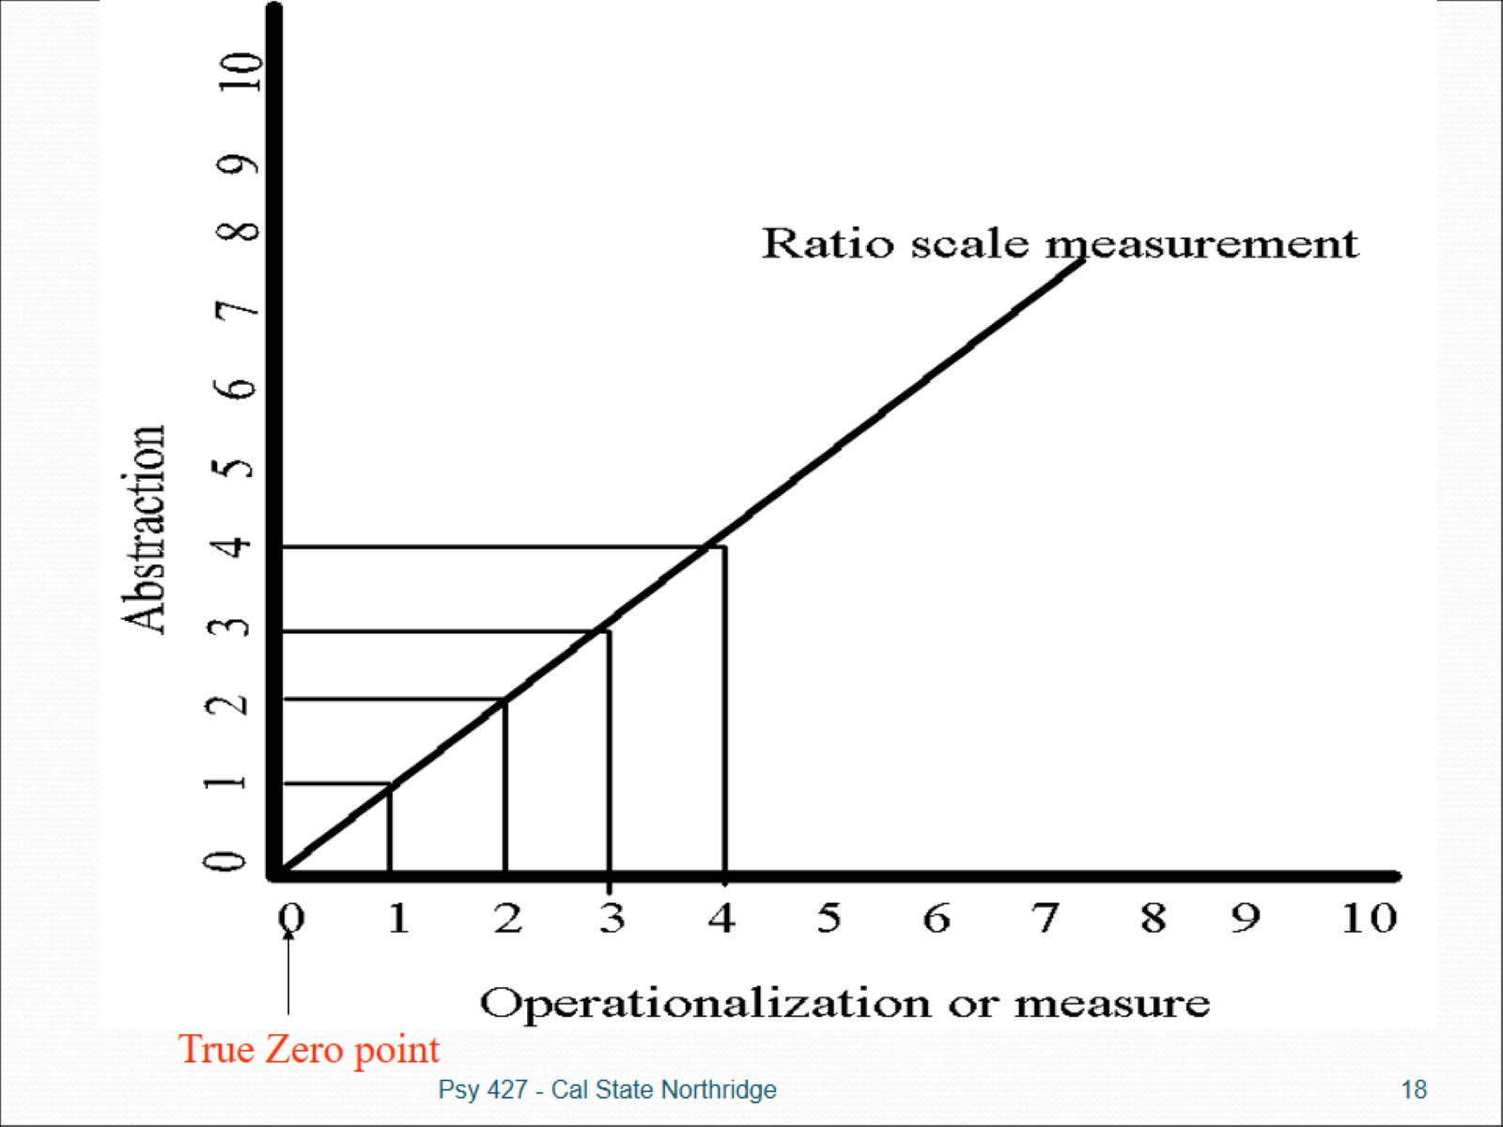

Slide 19
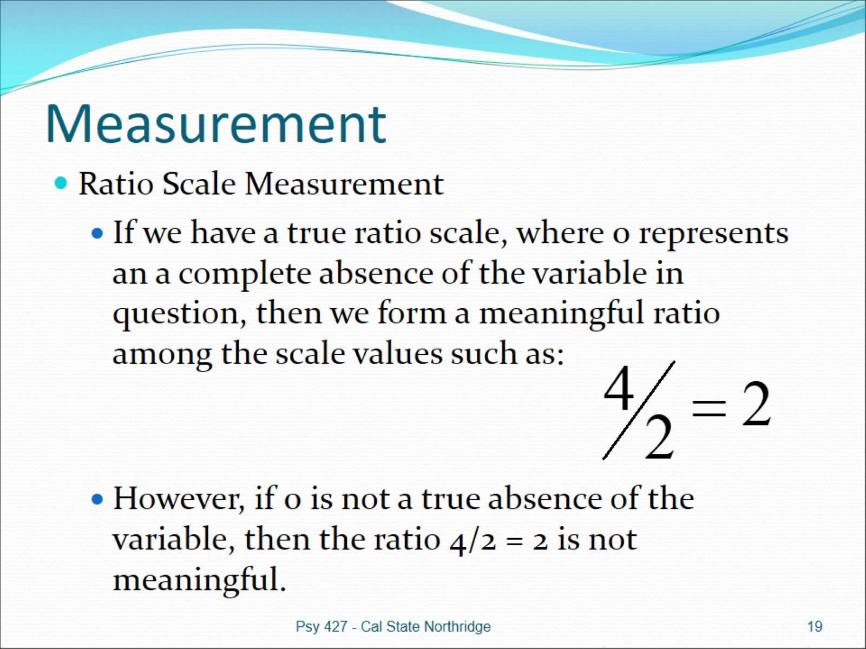
Measurement

Slide 20
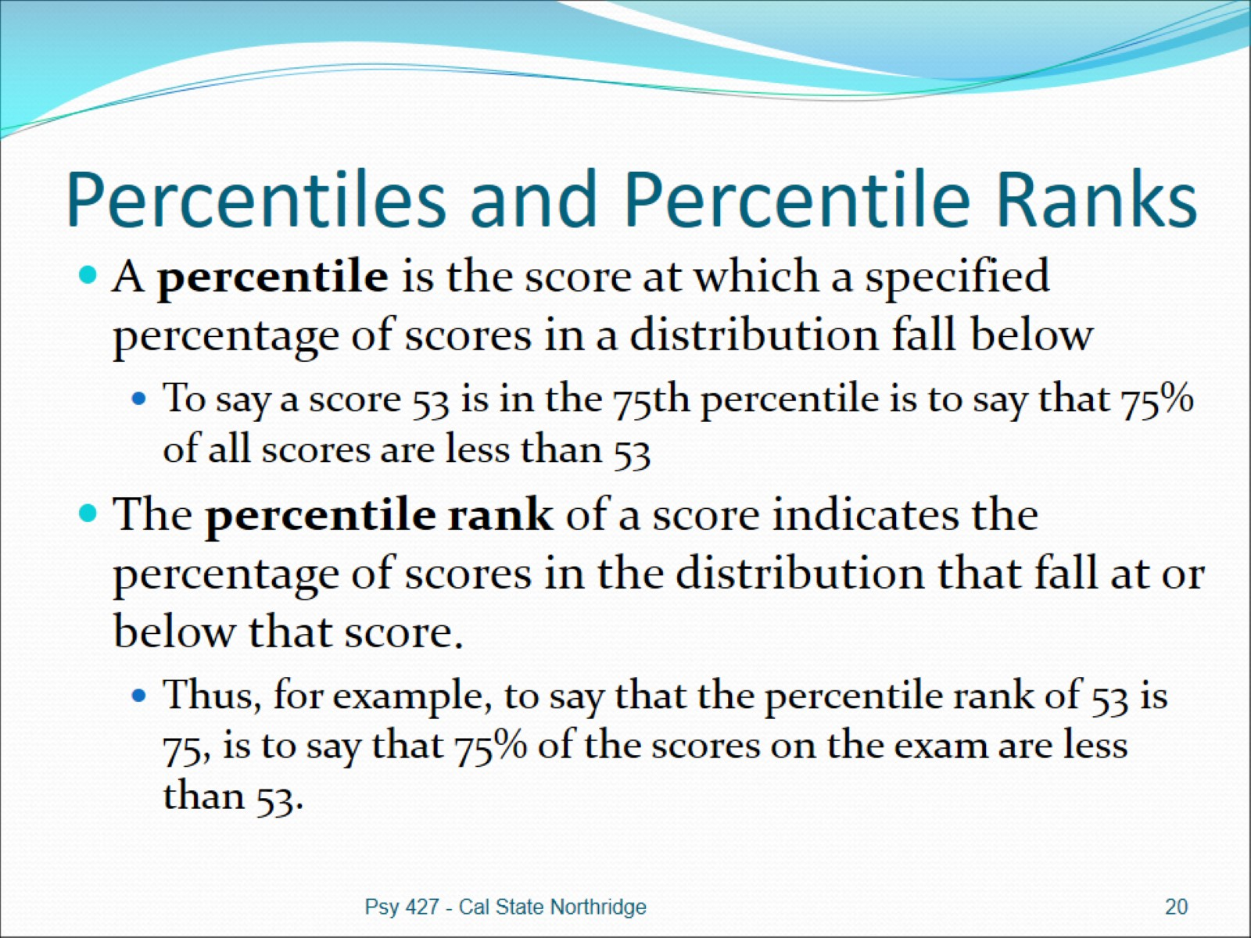
Percentiles and Percentile Ranks

Slide 21
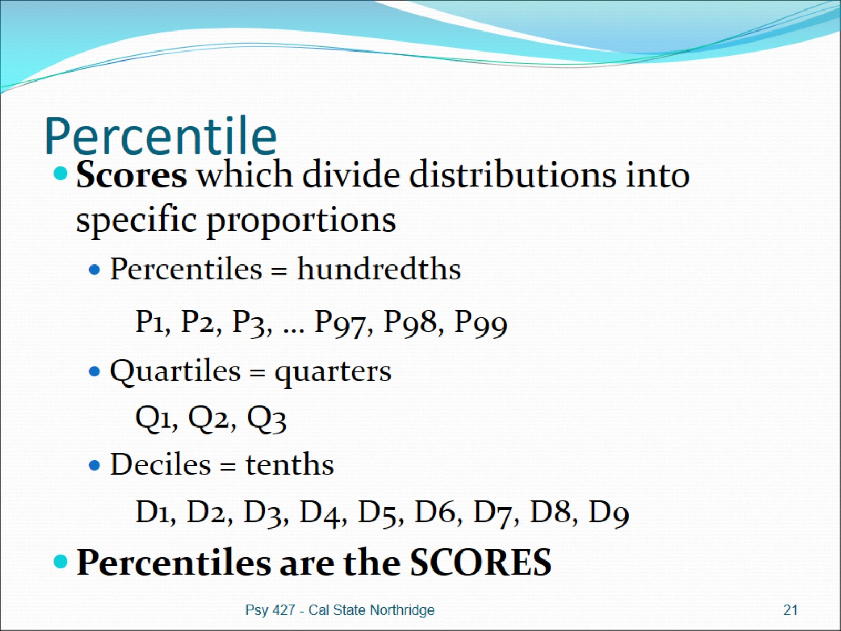
Percentile

Slide 22
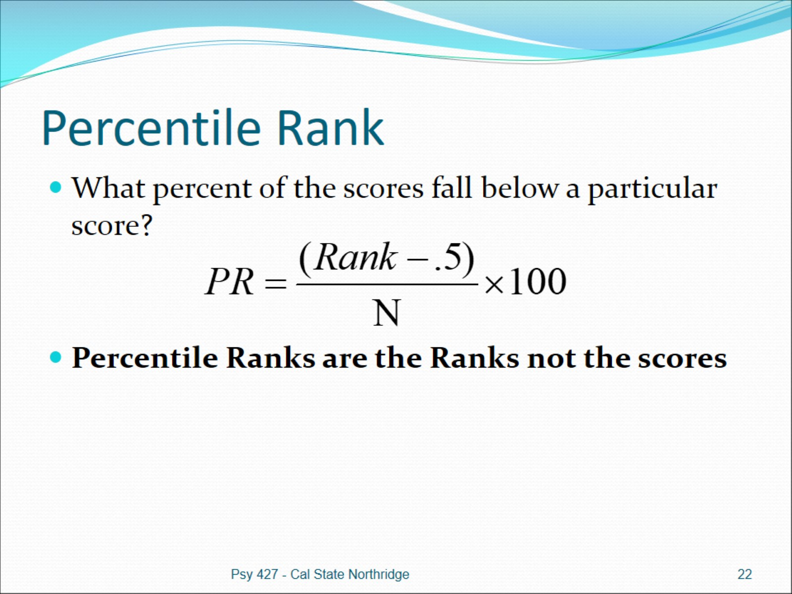
Percentile Rank

Slide 23
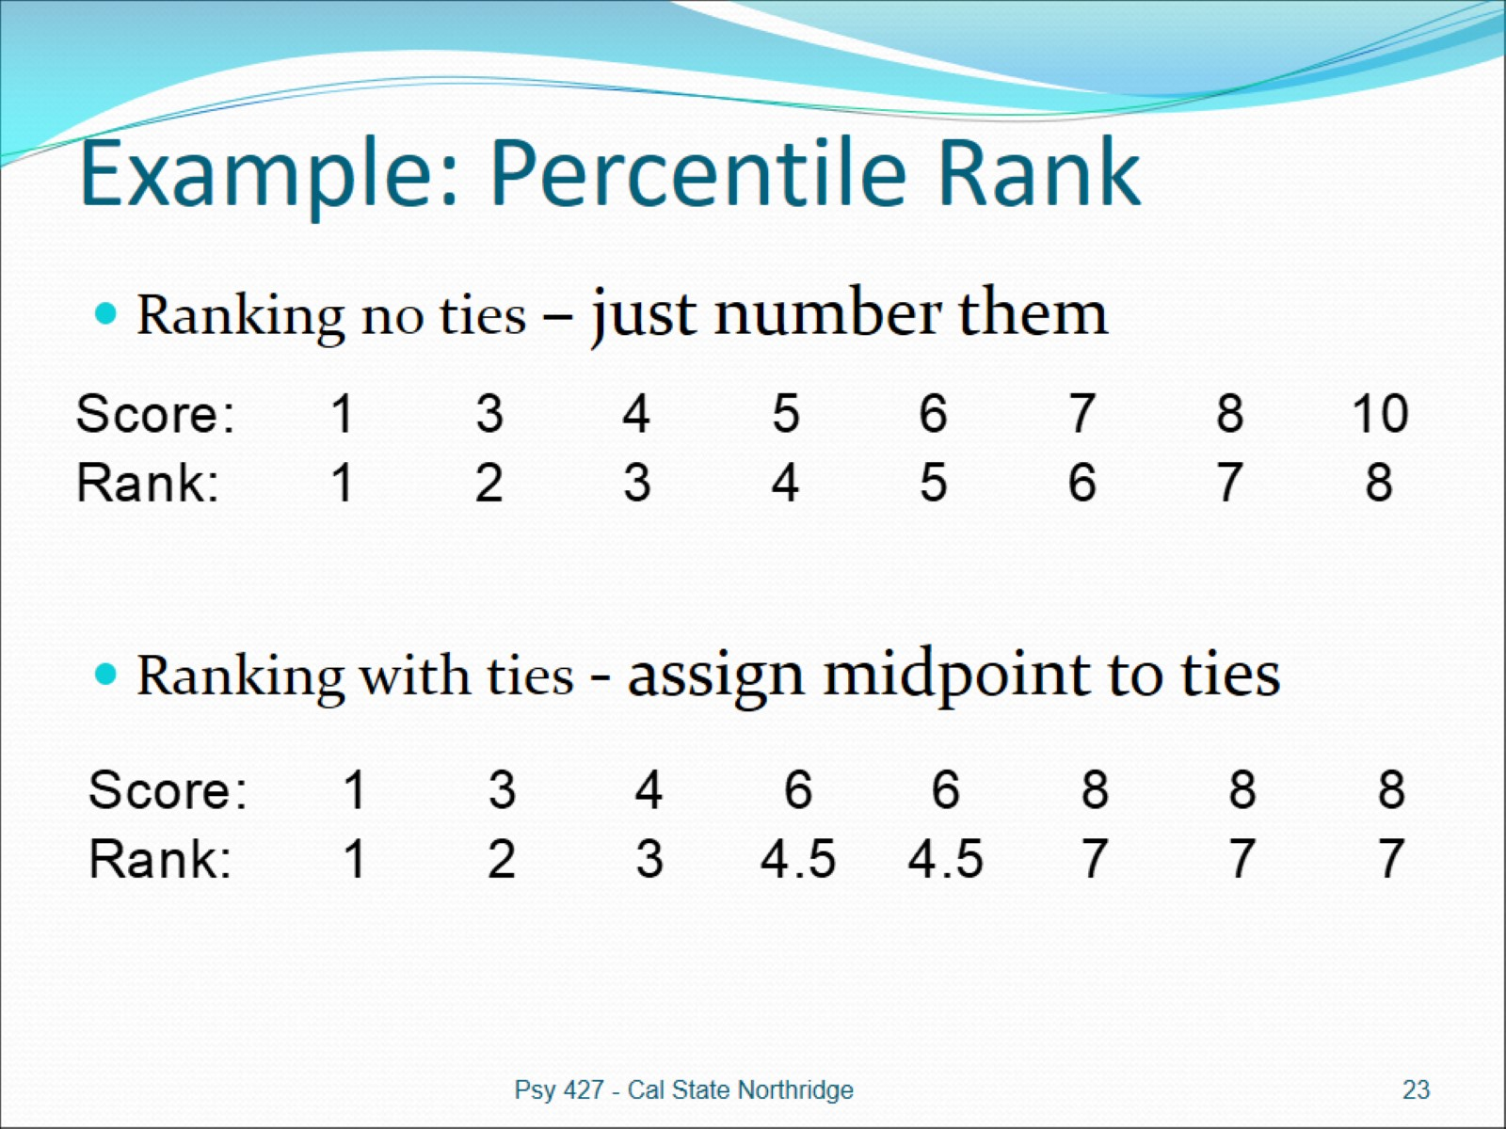
Example: Percentile Rank

Slide 24
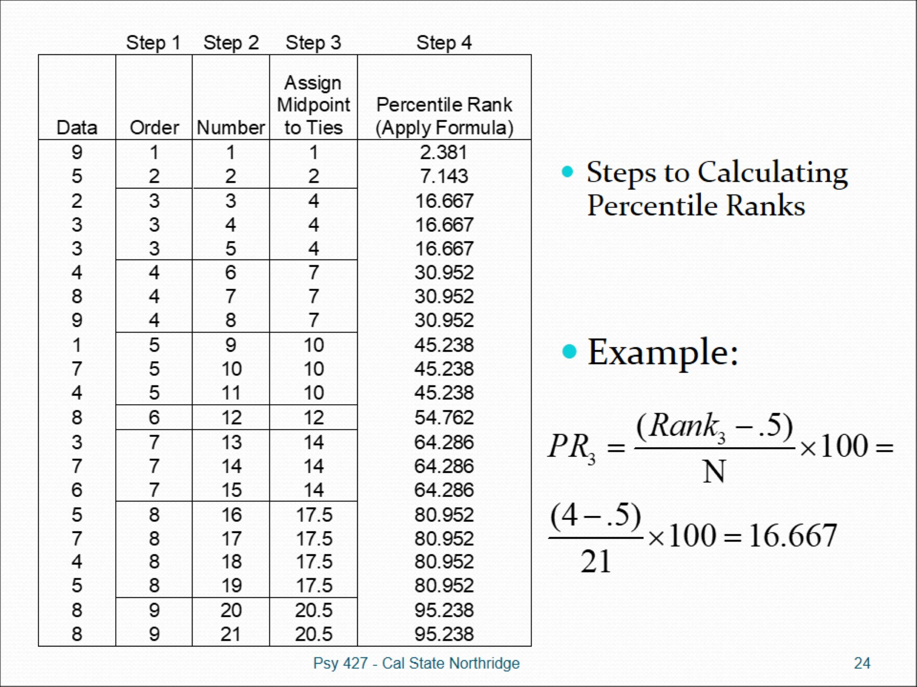

Slide 25
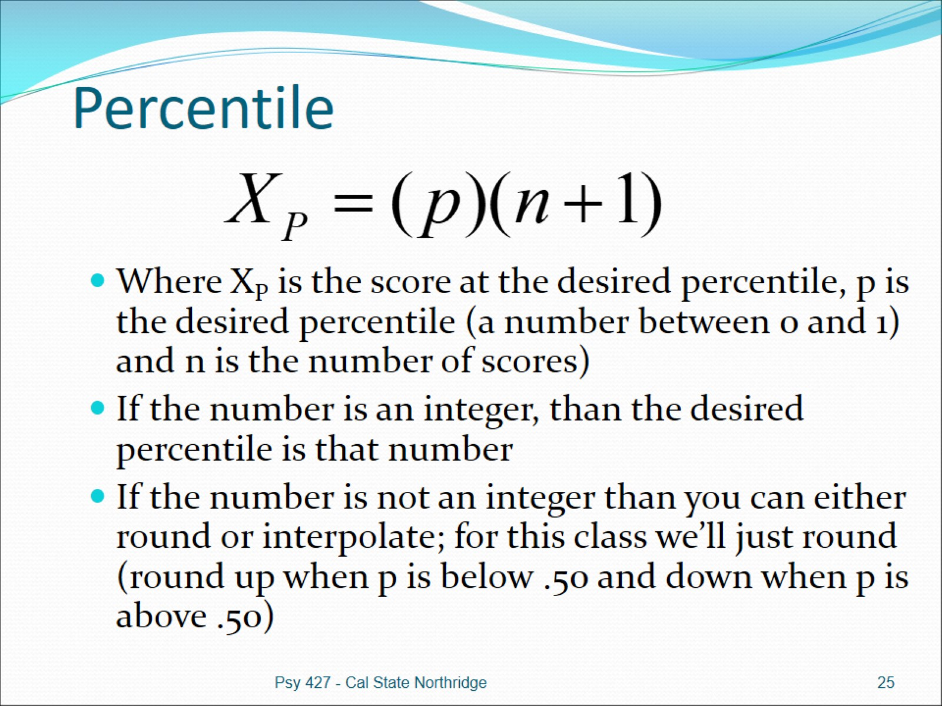
Percentile

Slide 26
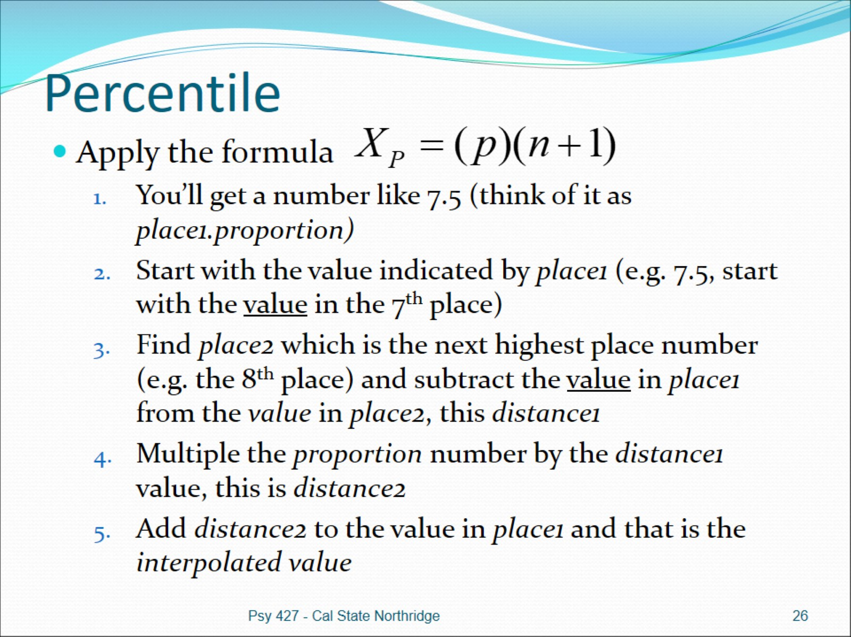
Percentile

Slide 27
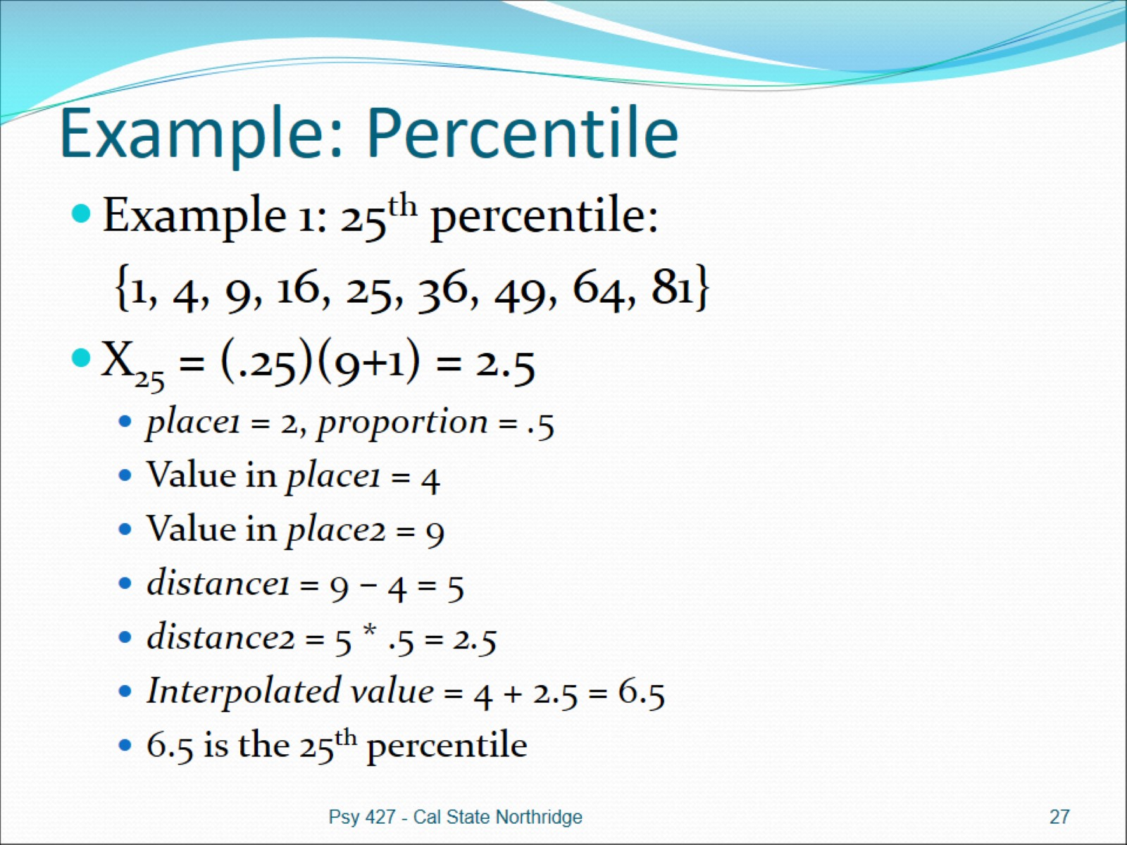
Example: Percentile

Slide 28
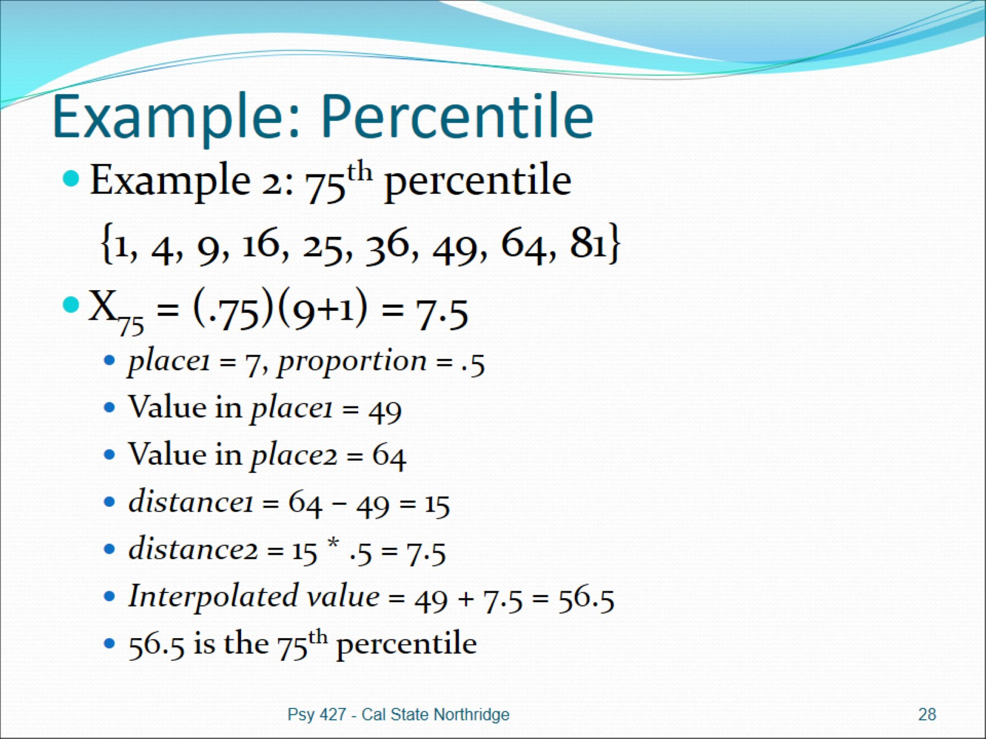
Example: Percentile

Slide 29
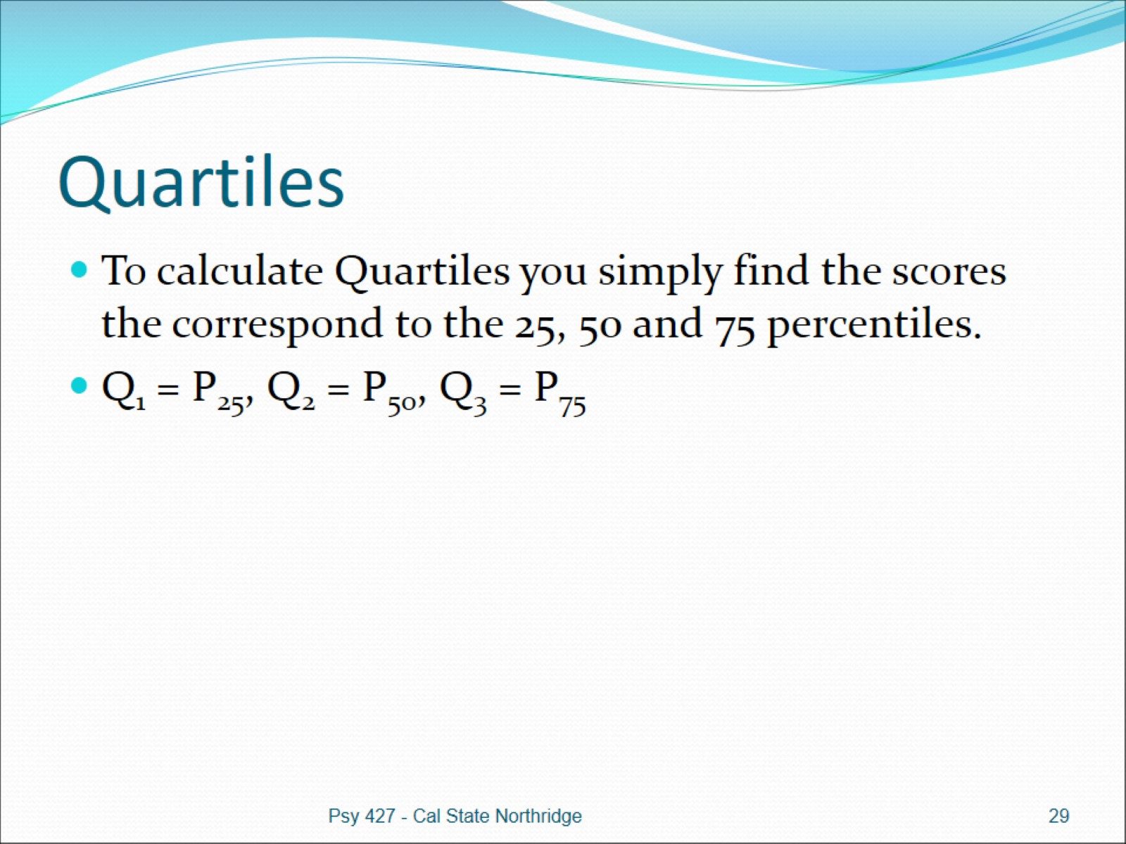
Quartiles

Slide 30
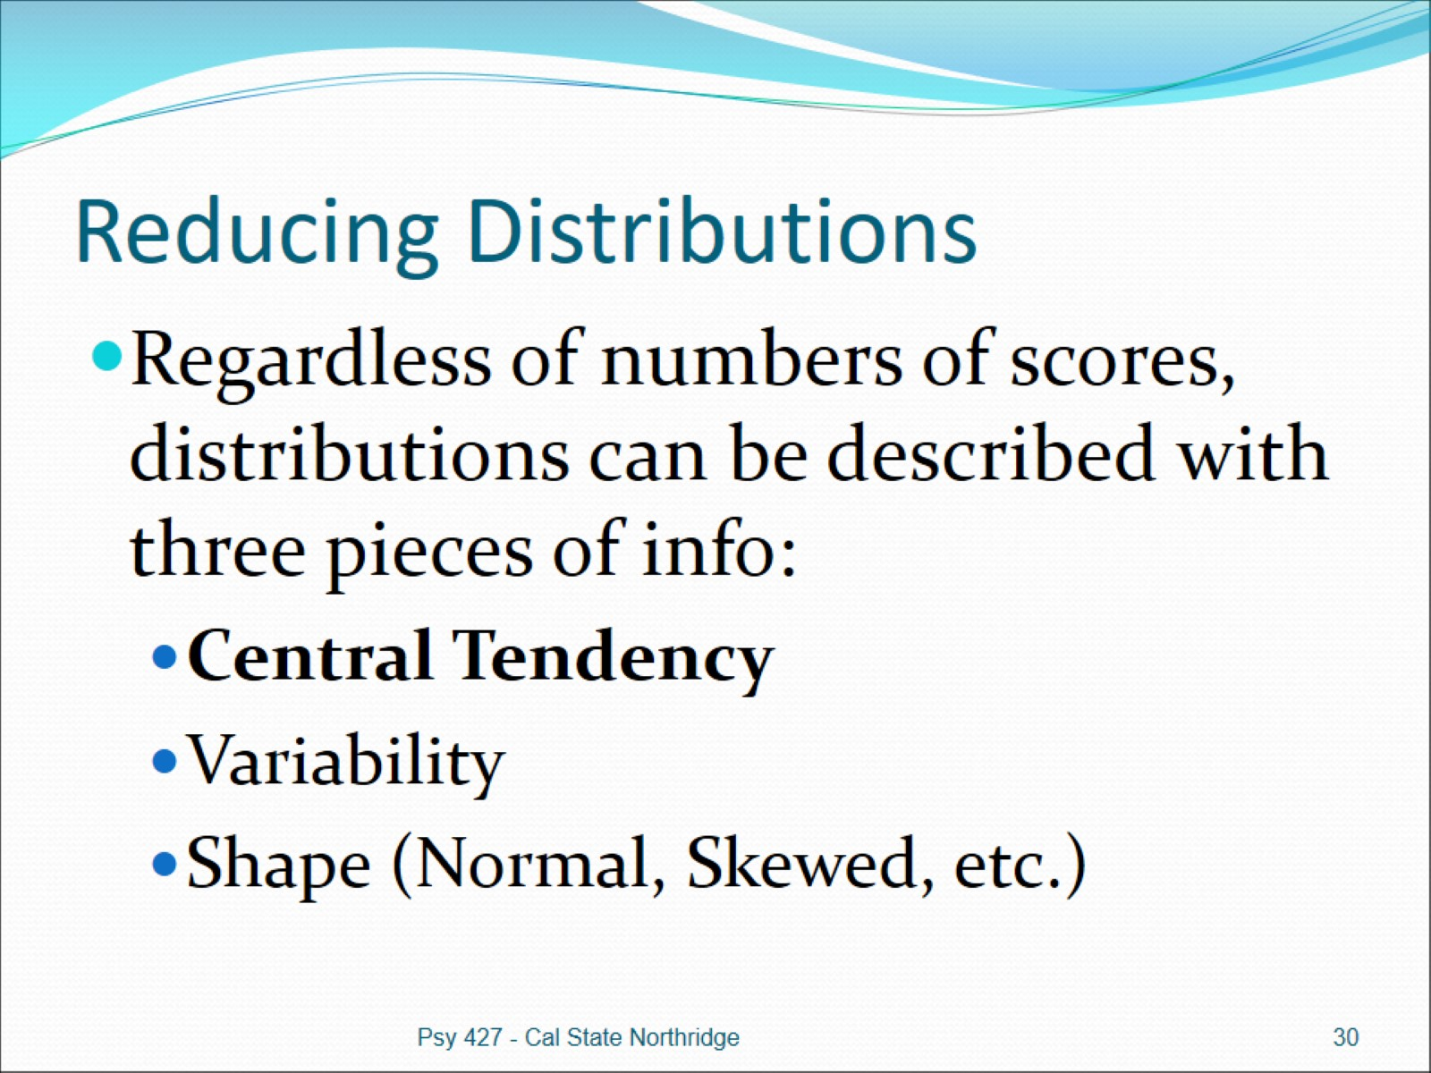
Reducing Distributions

Slide 31
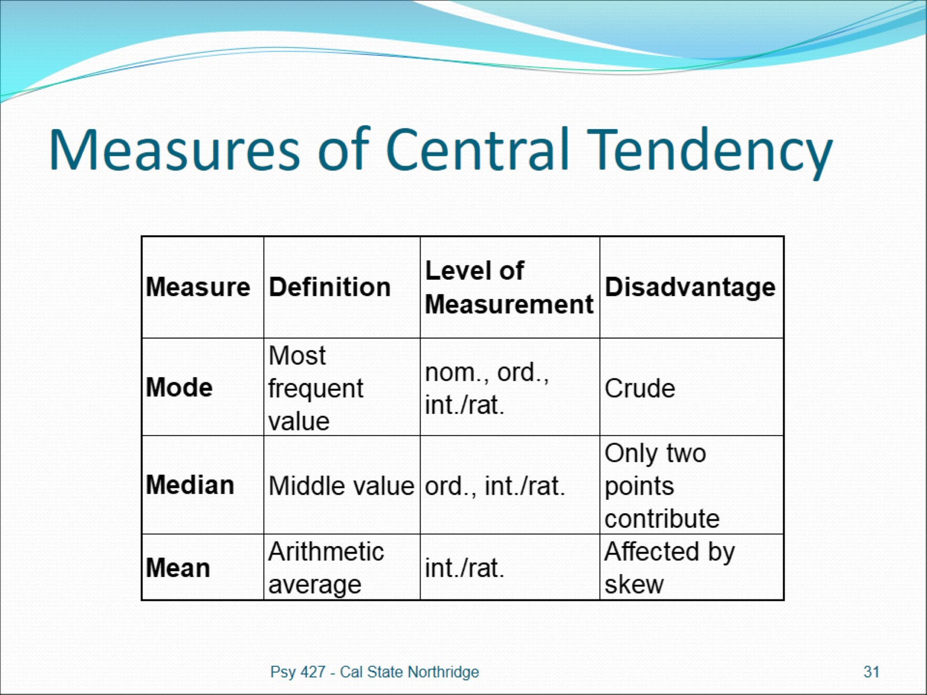
Measures of Central Tendency

Slide 32
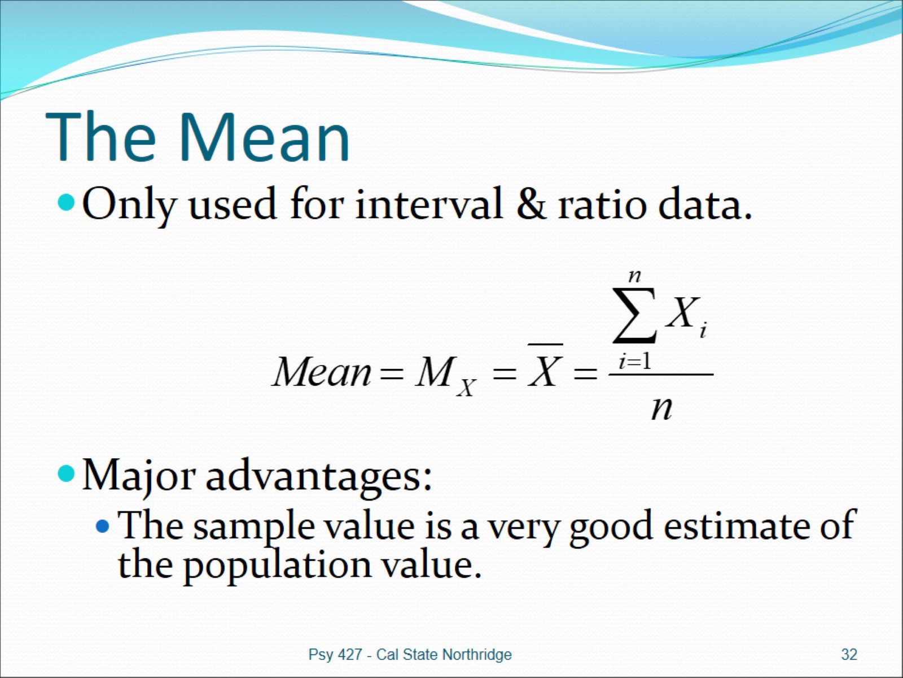
The Mean

Slide 33
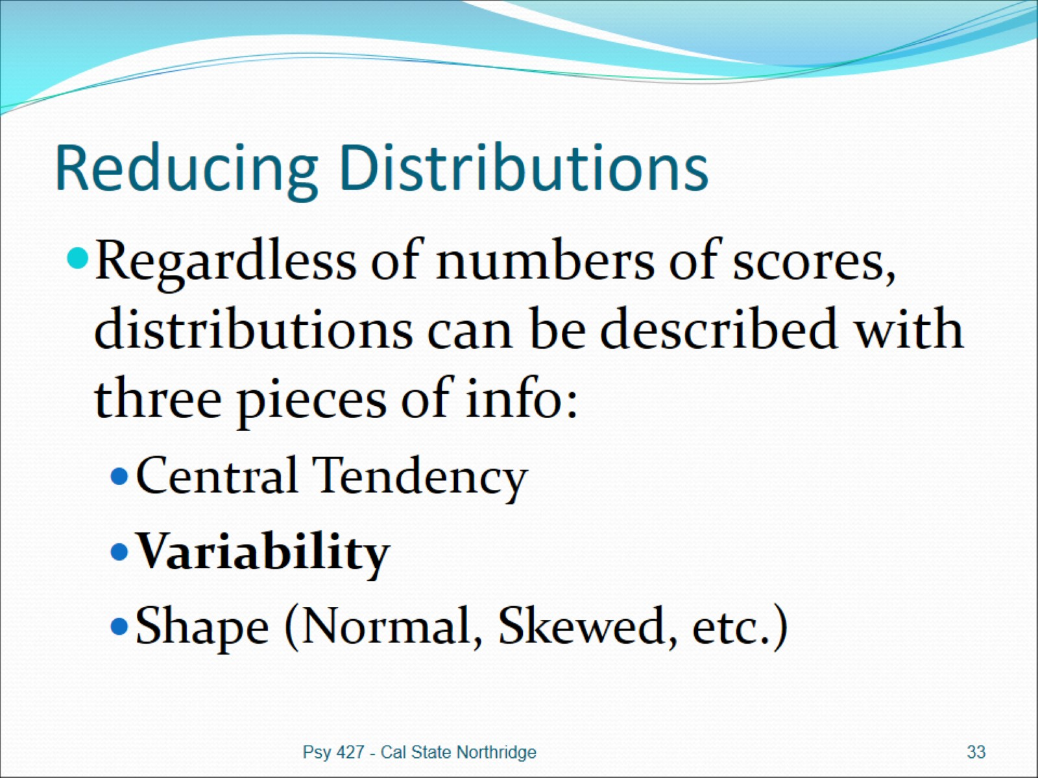
Reducing Distributions

Slide 34
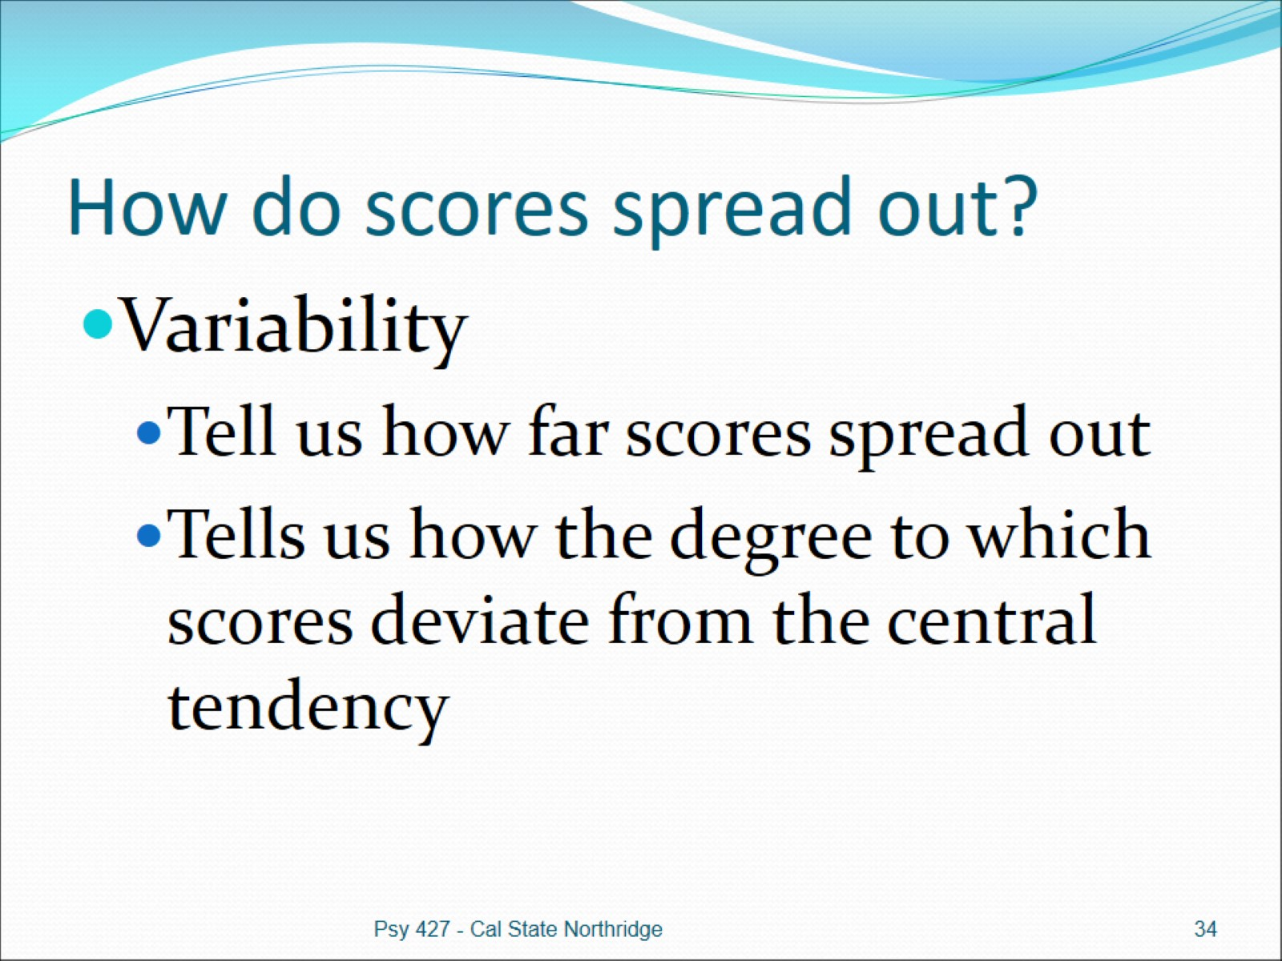
How do scores spread out?

Slide 35
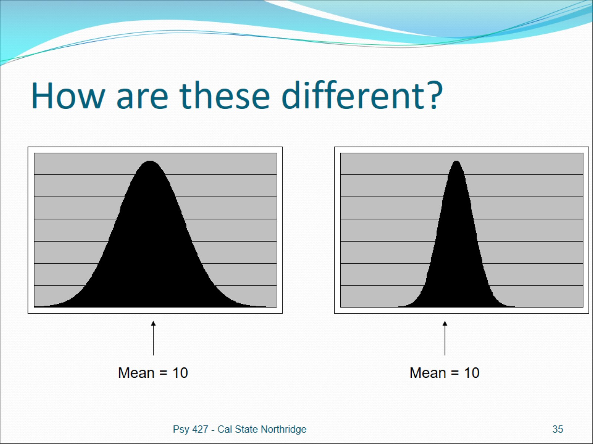
How are these different?

Slide 36
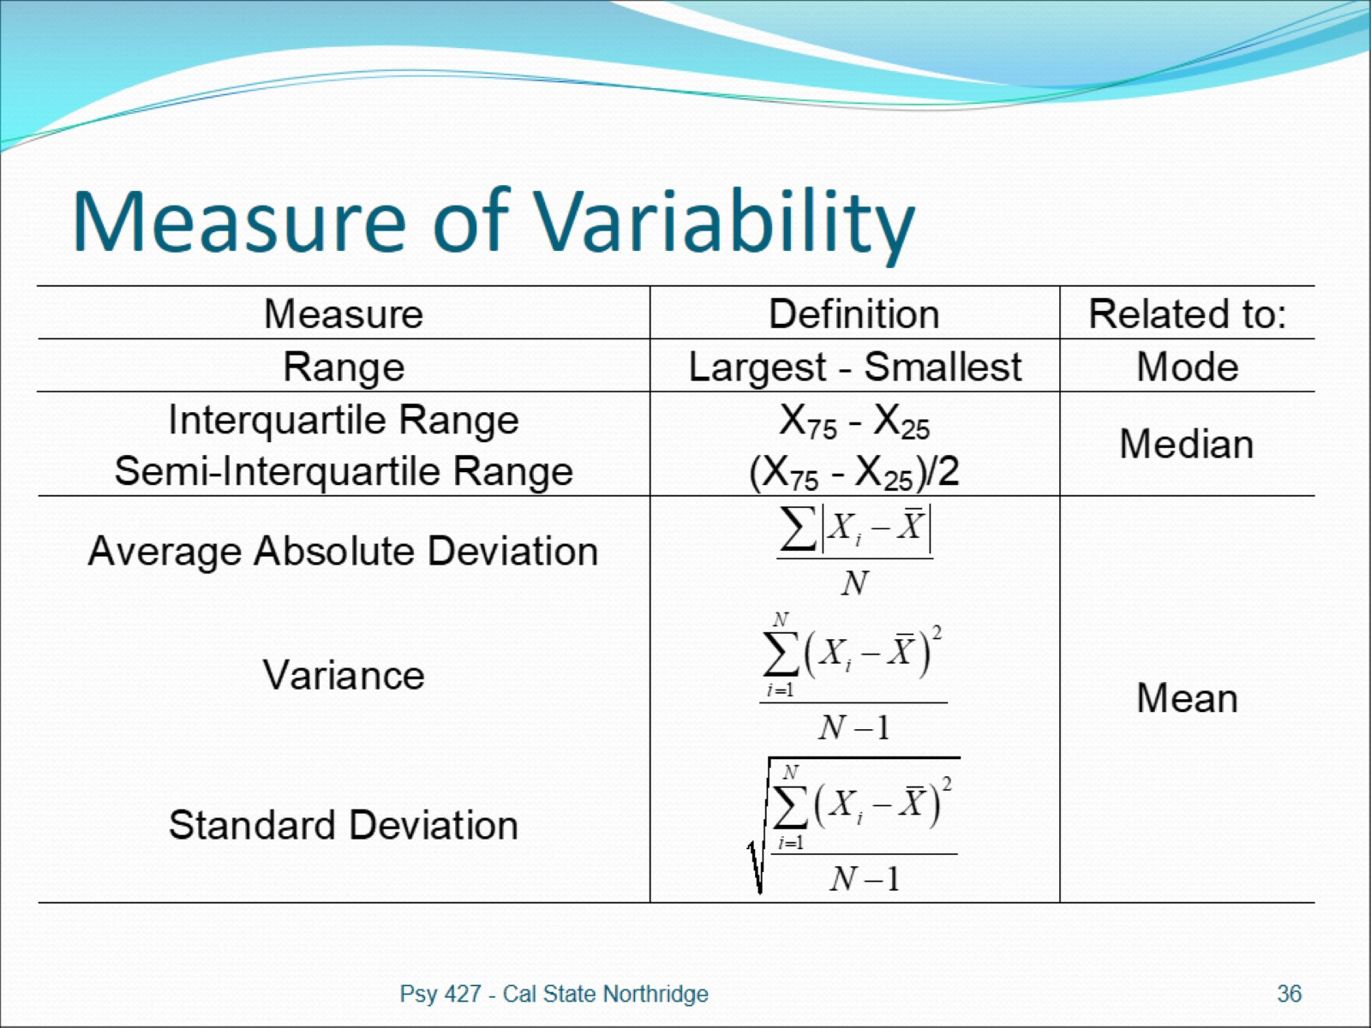
Measure of Variability

Slide 37
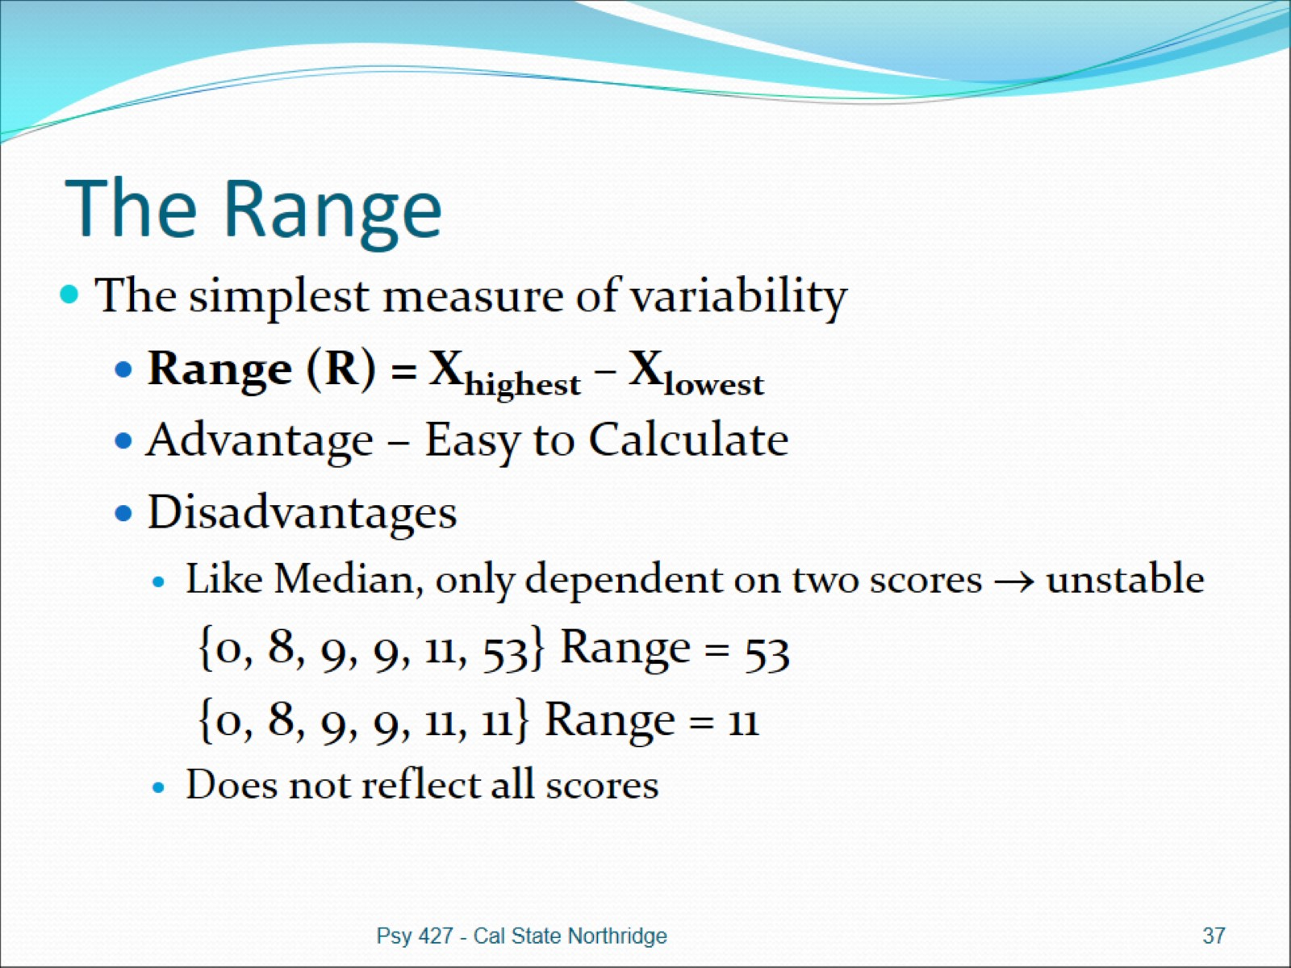
The Range

Slide 38
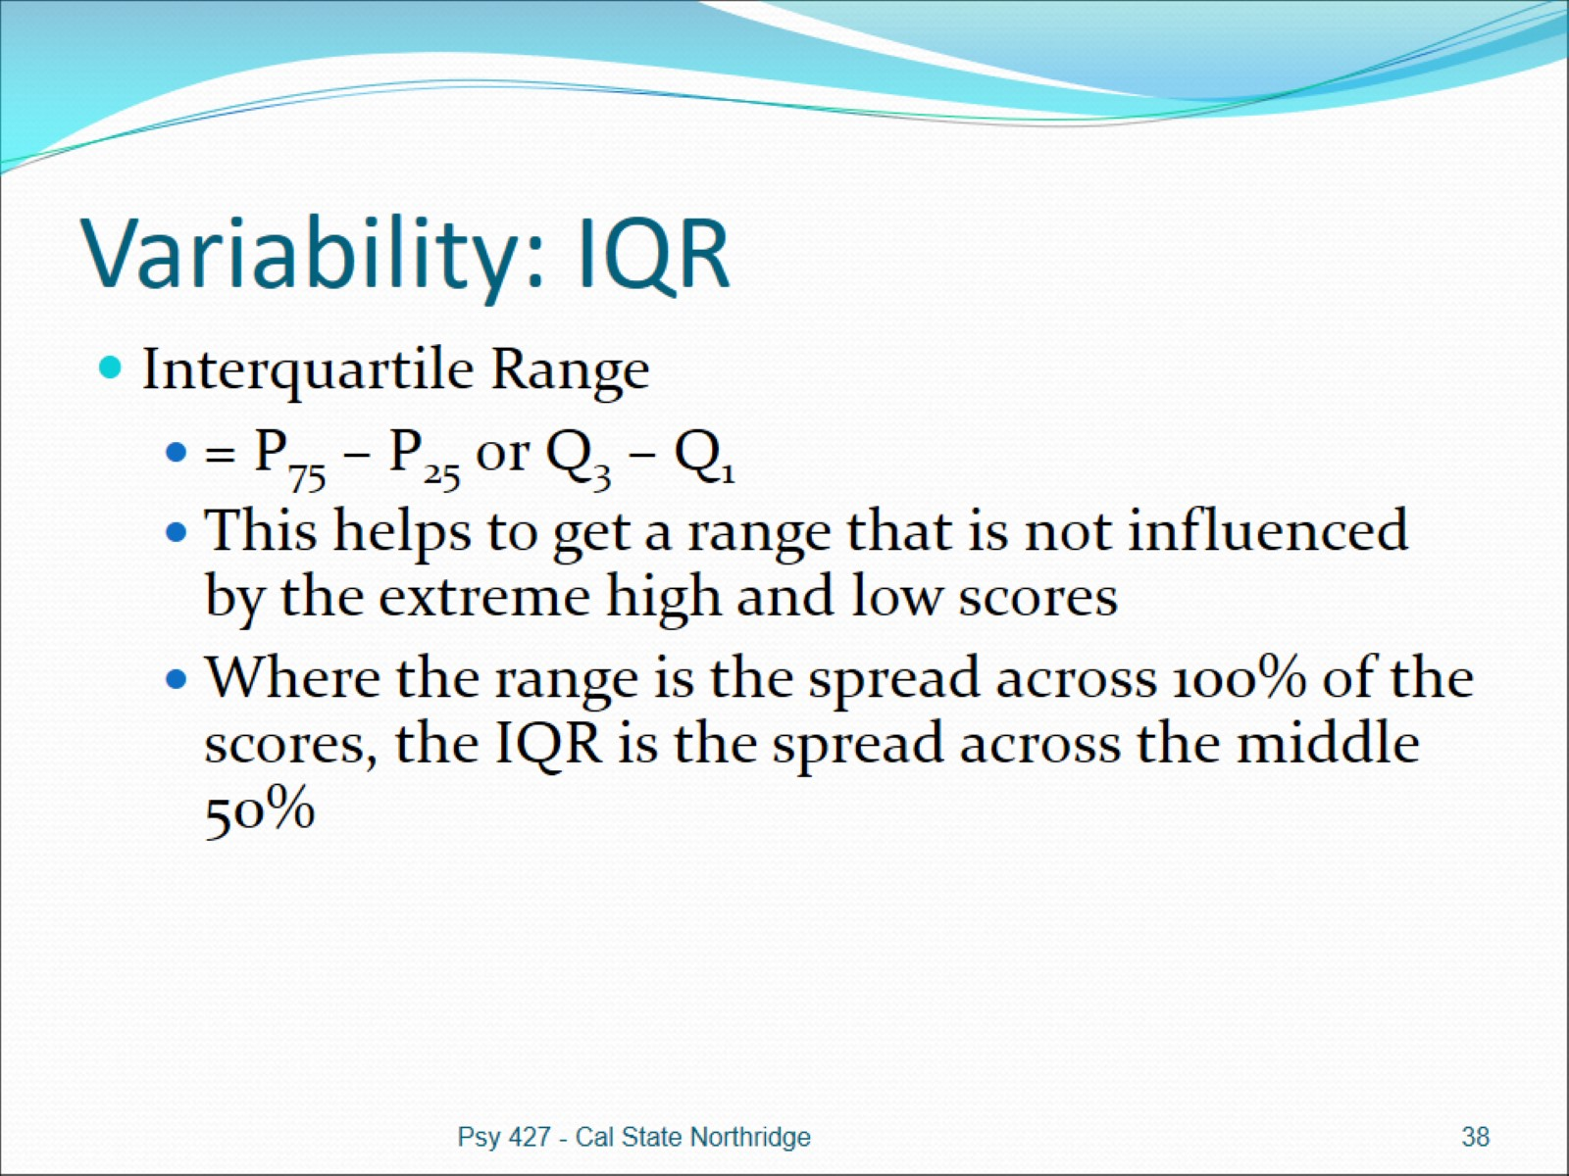
Variability: IQR

Slide 39
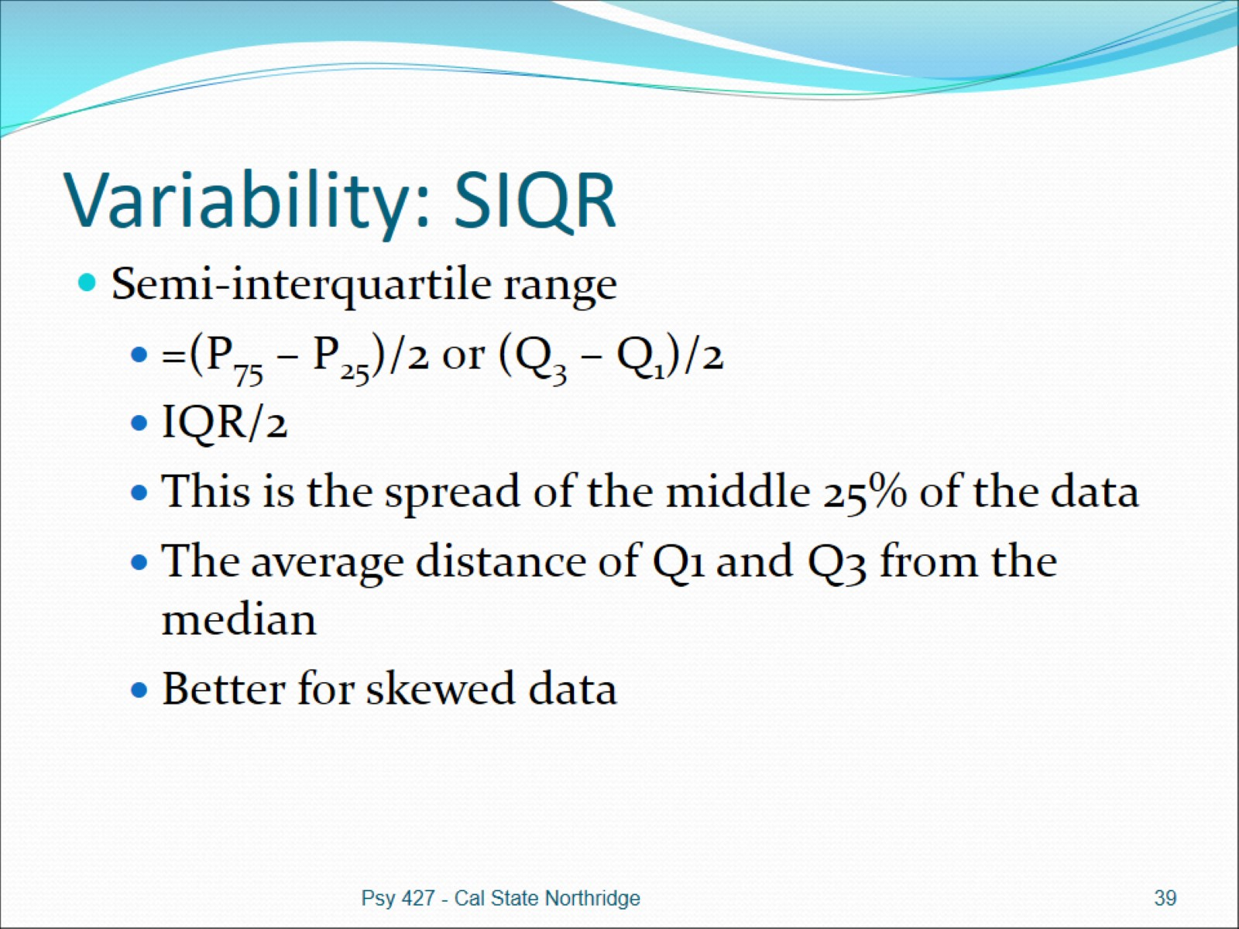
Variability: SIQR

Slide 40
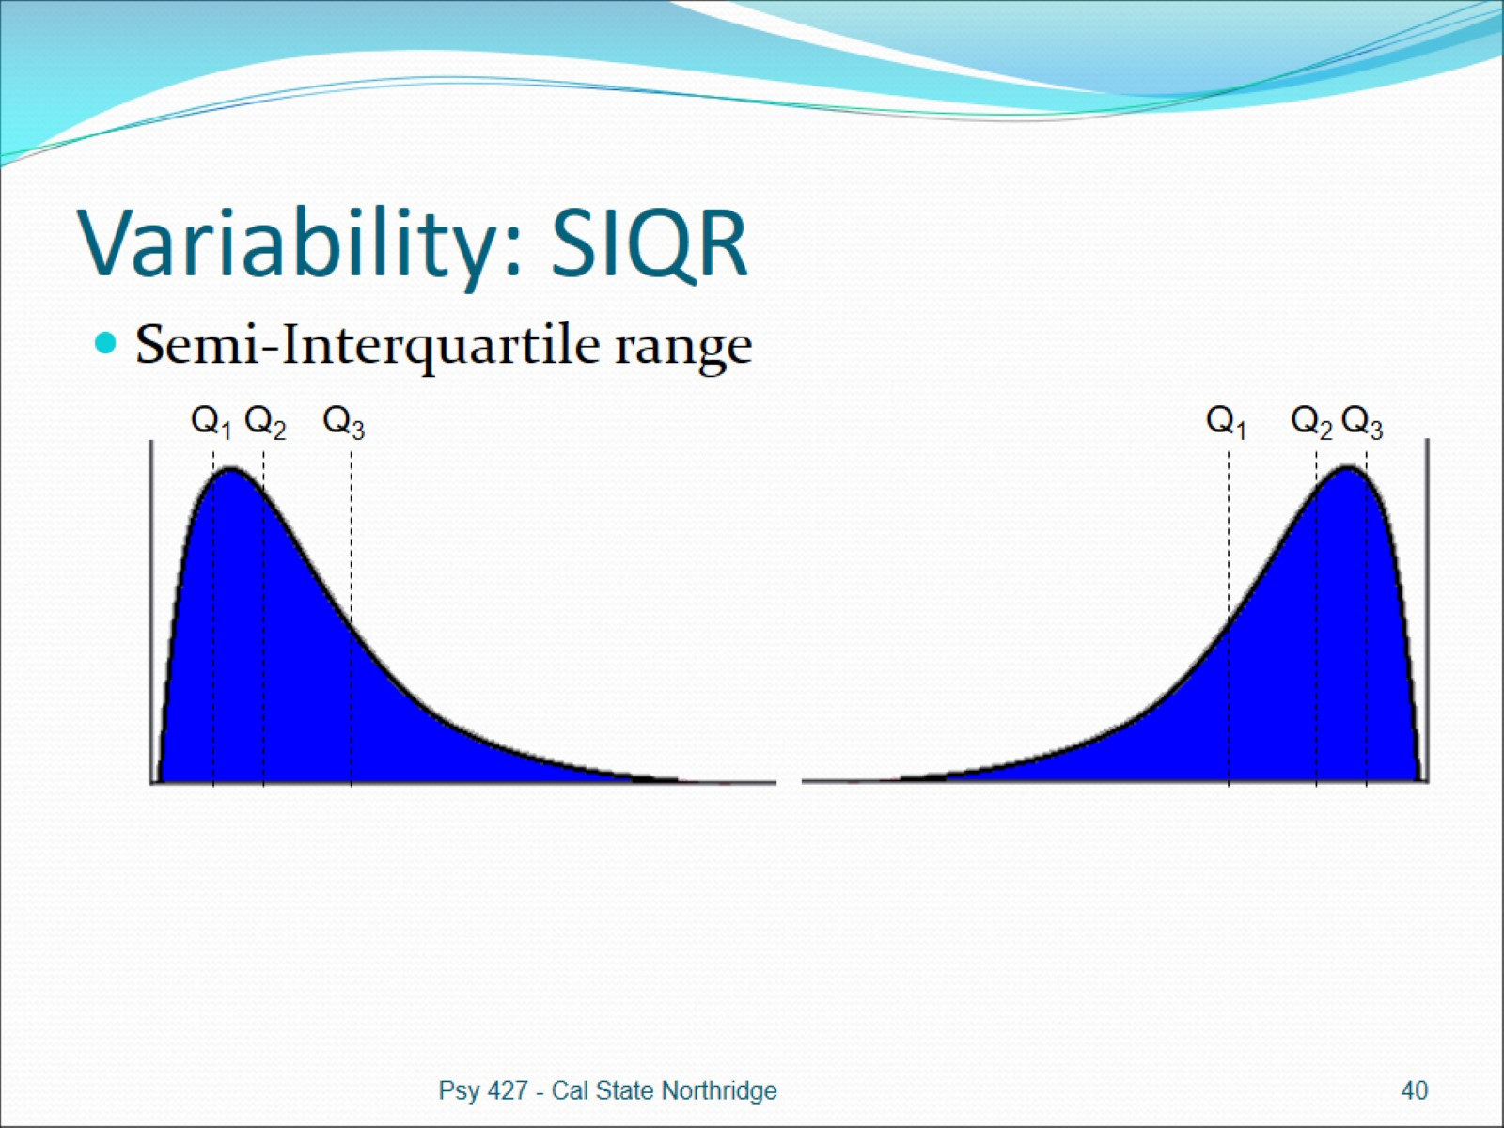
Variability: SIQR

Slide 41
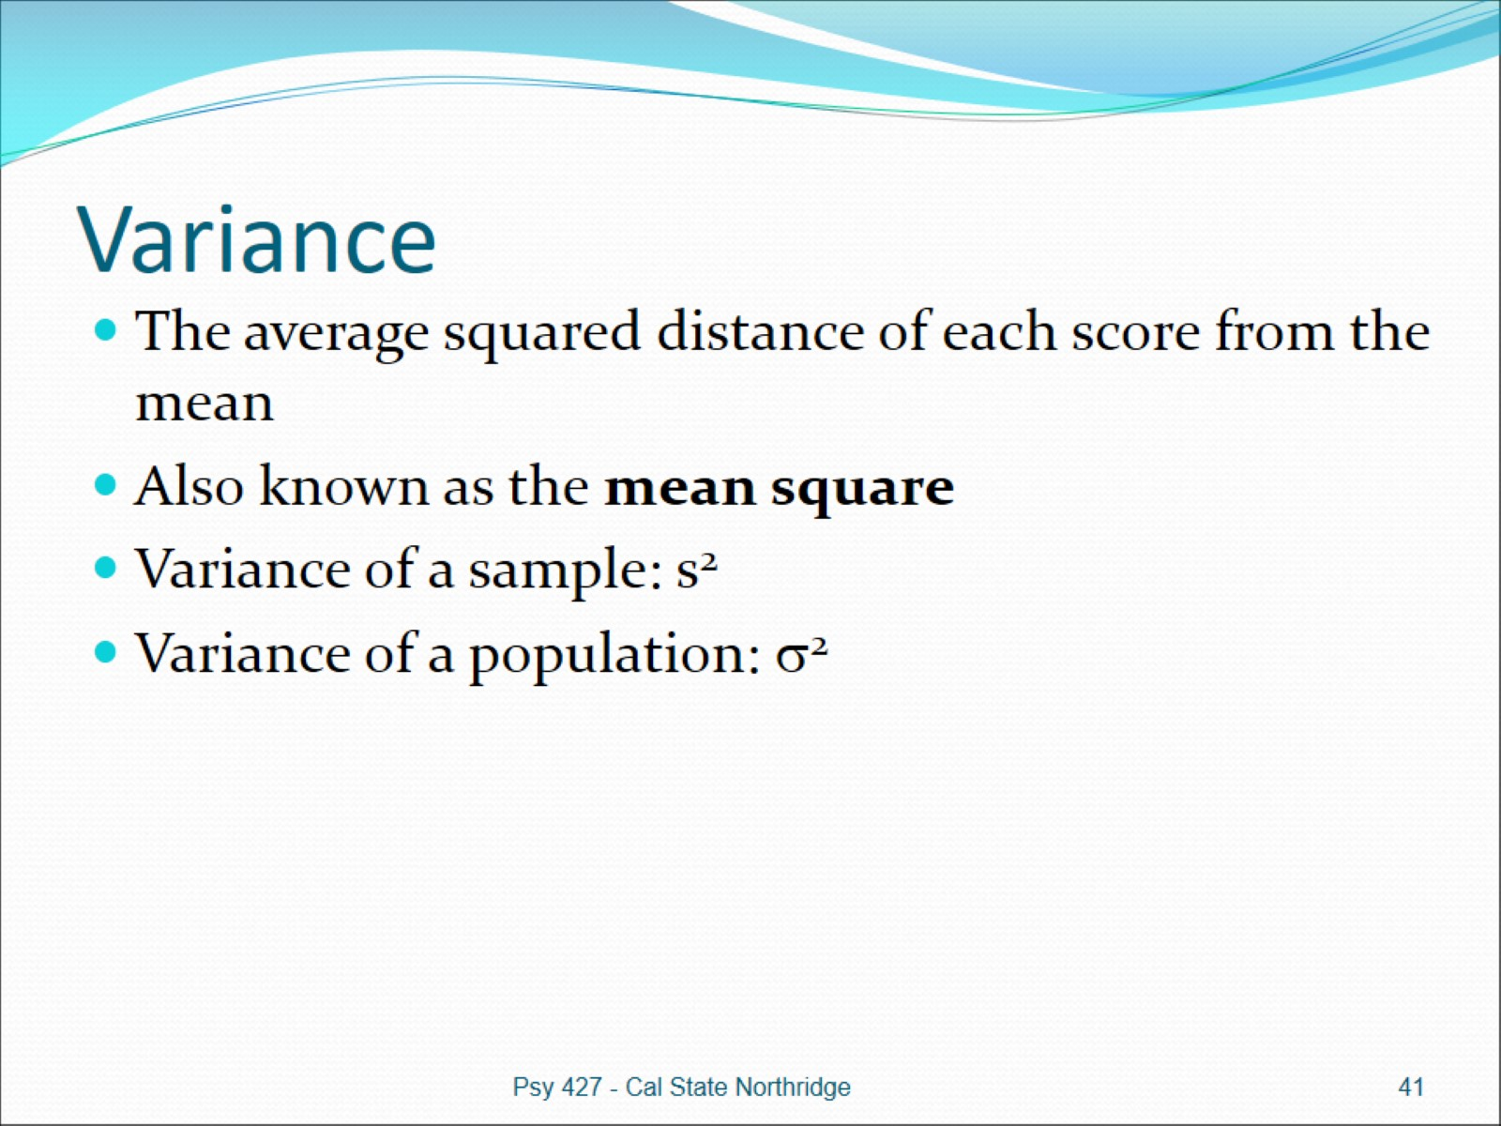
Variance

Slide 42
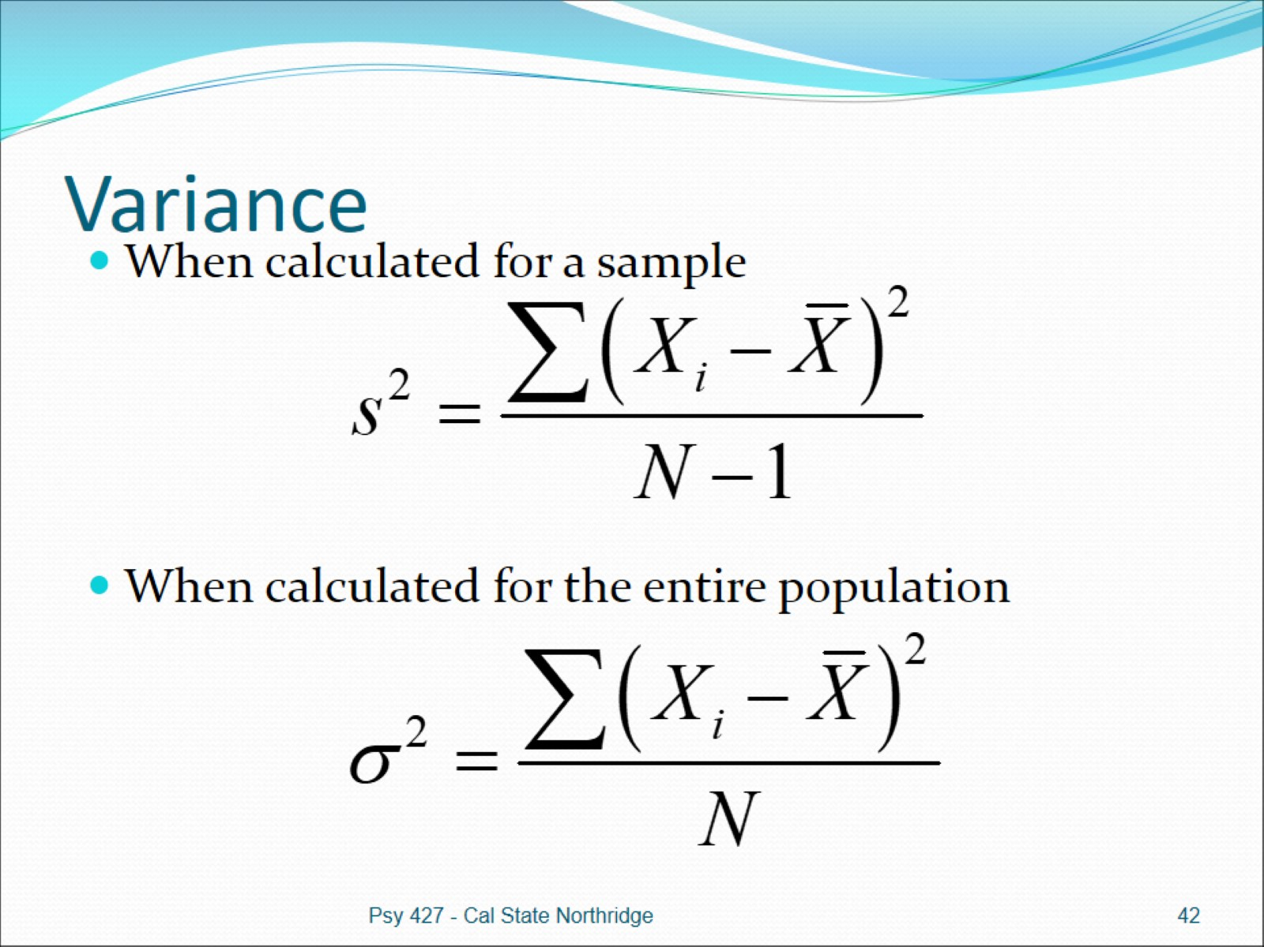
Variance

Slide 43
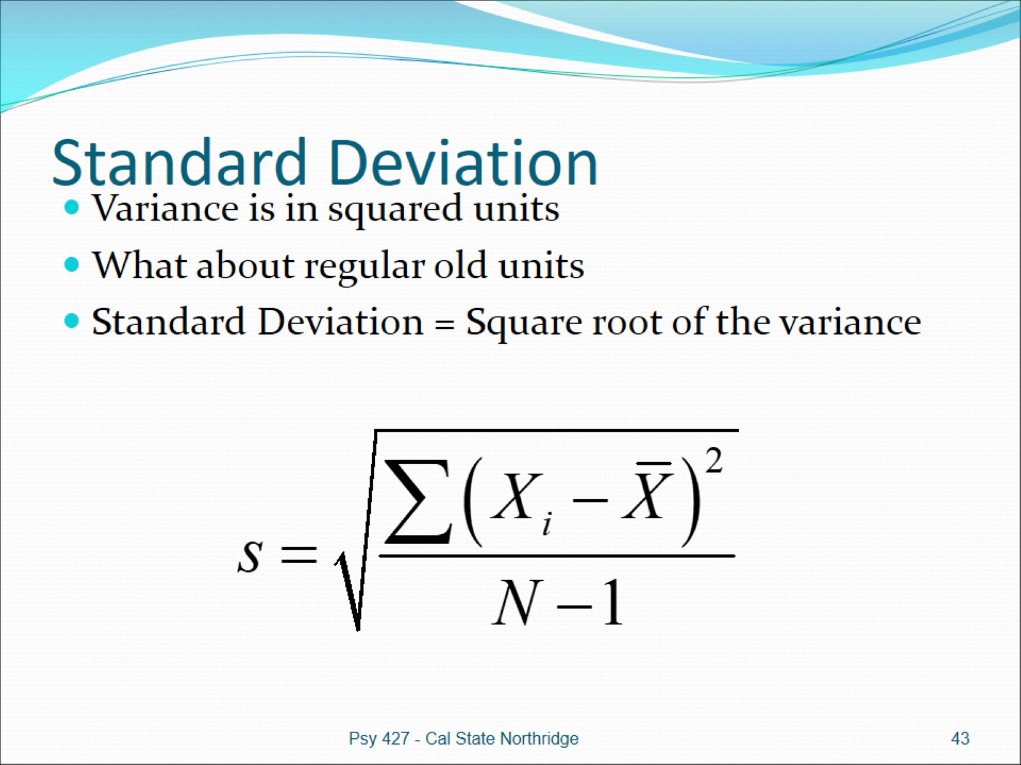
Standard Deviation

Slide 44
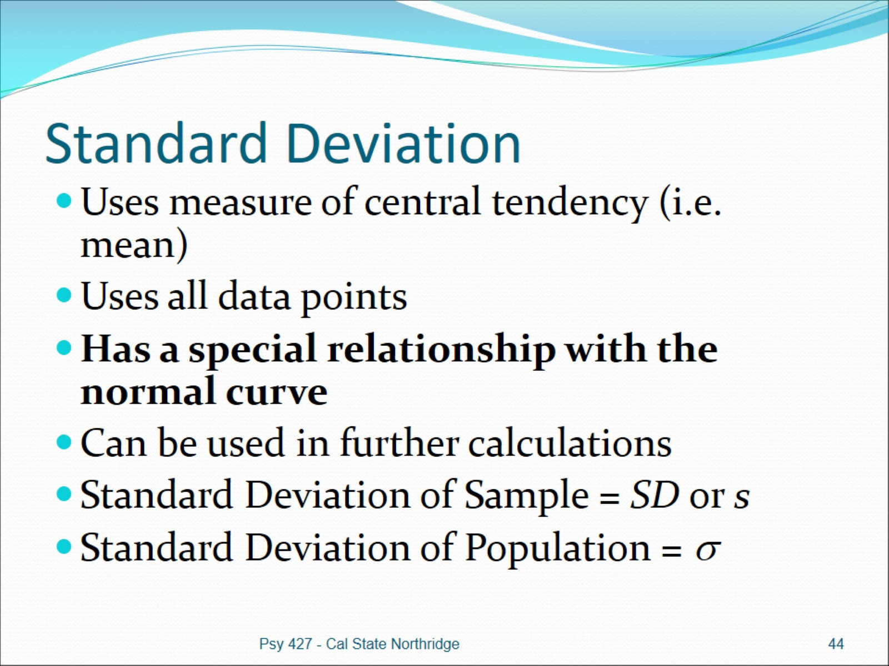
Standard Deviation

Slide 45
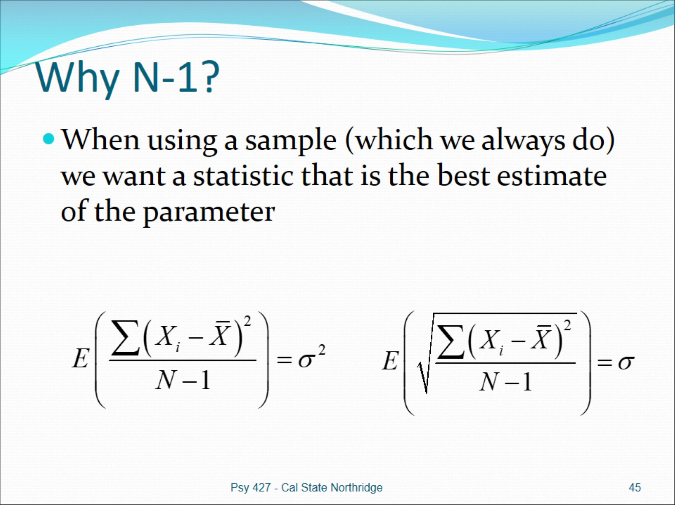
Why N-1?

Slide 46
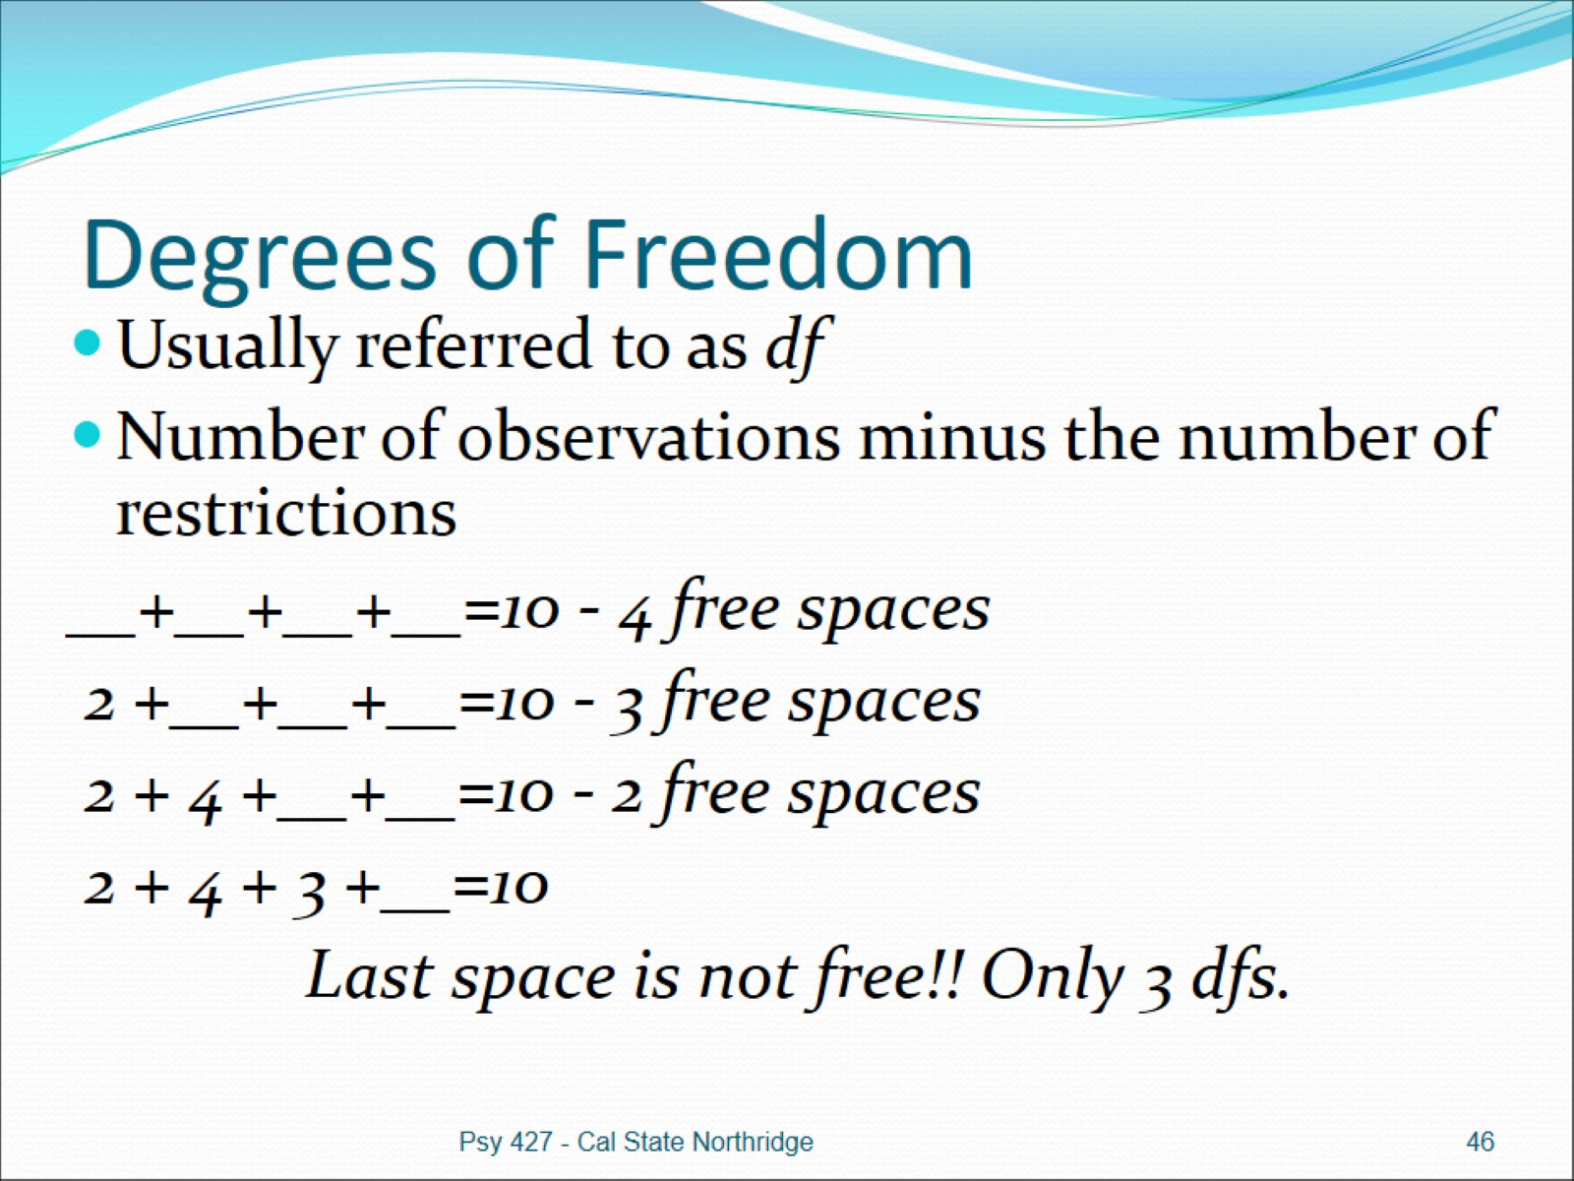
Degrees of Freedom

Slide 47
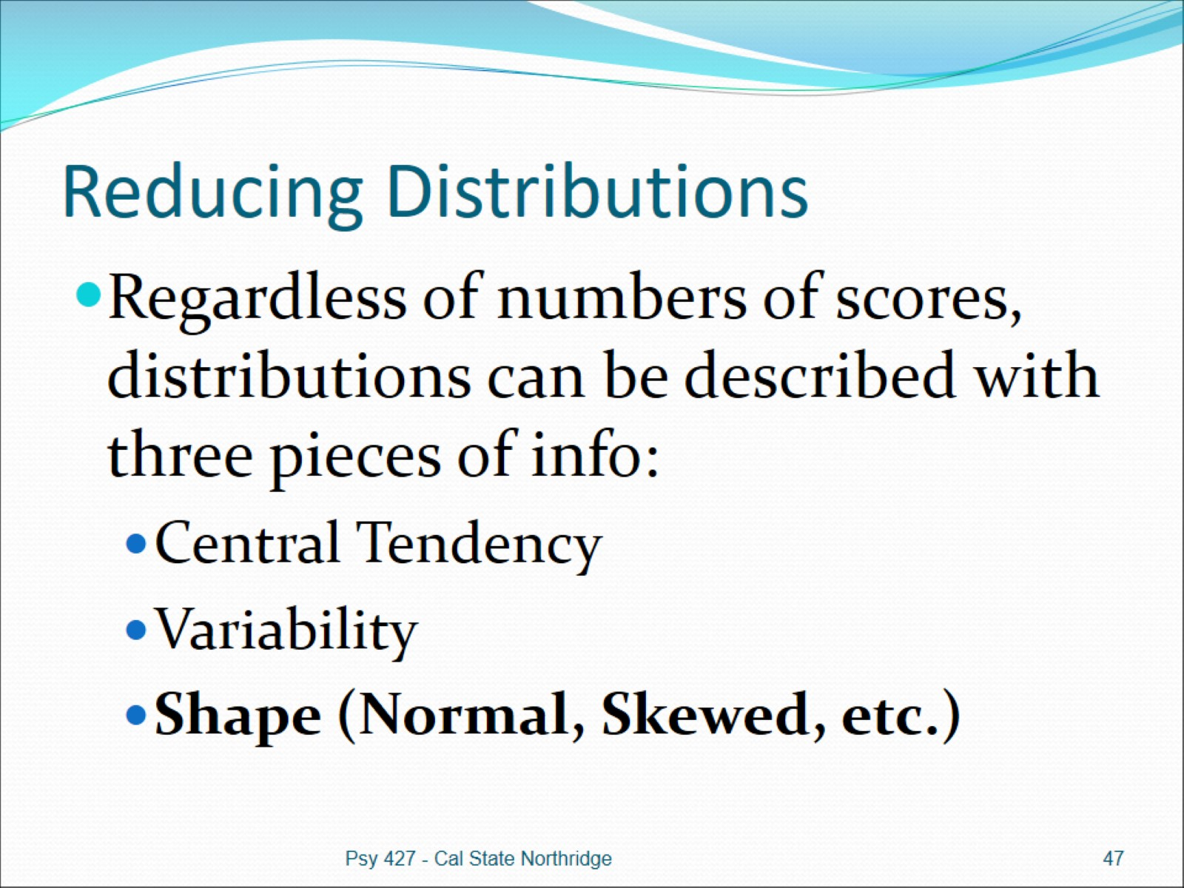
Reducing Distributions

Slide 48
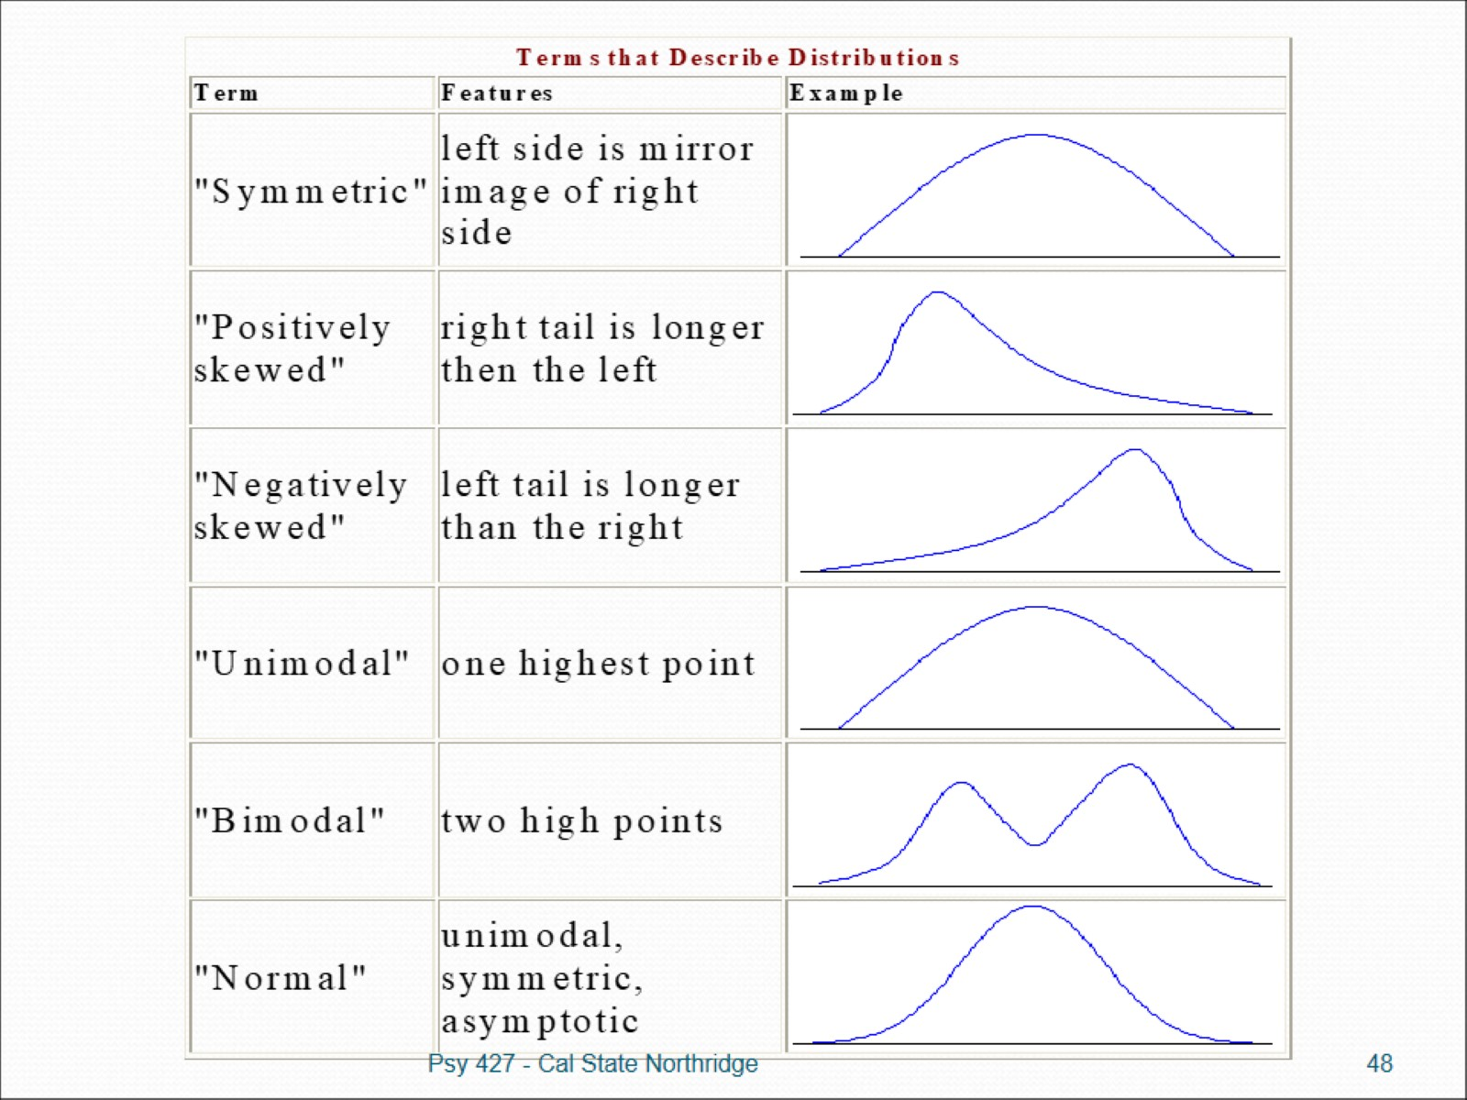

Slide 49
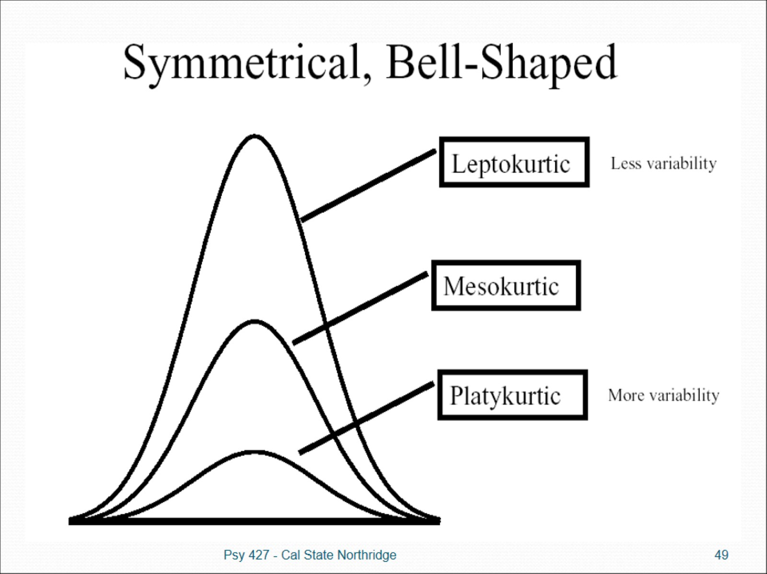

Slide 50
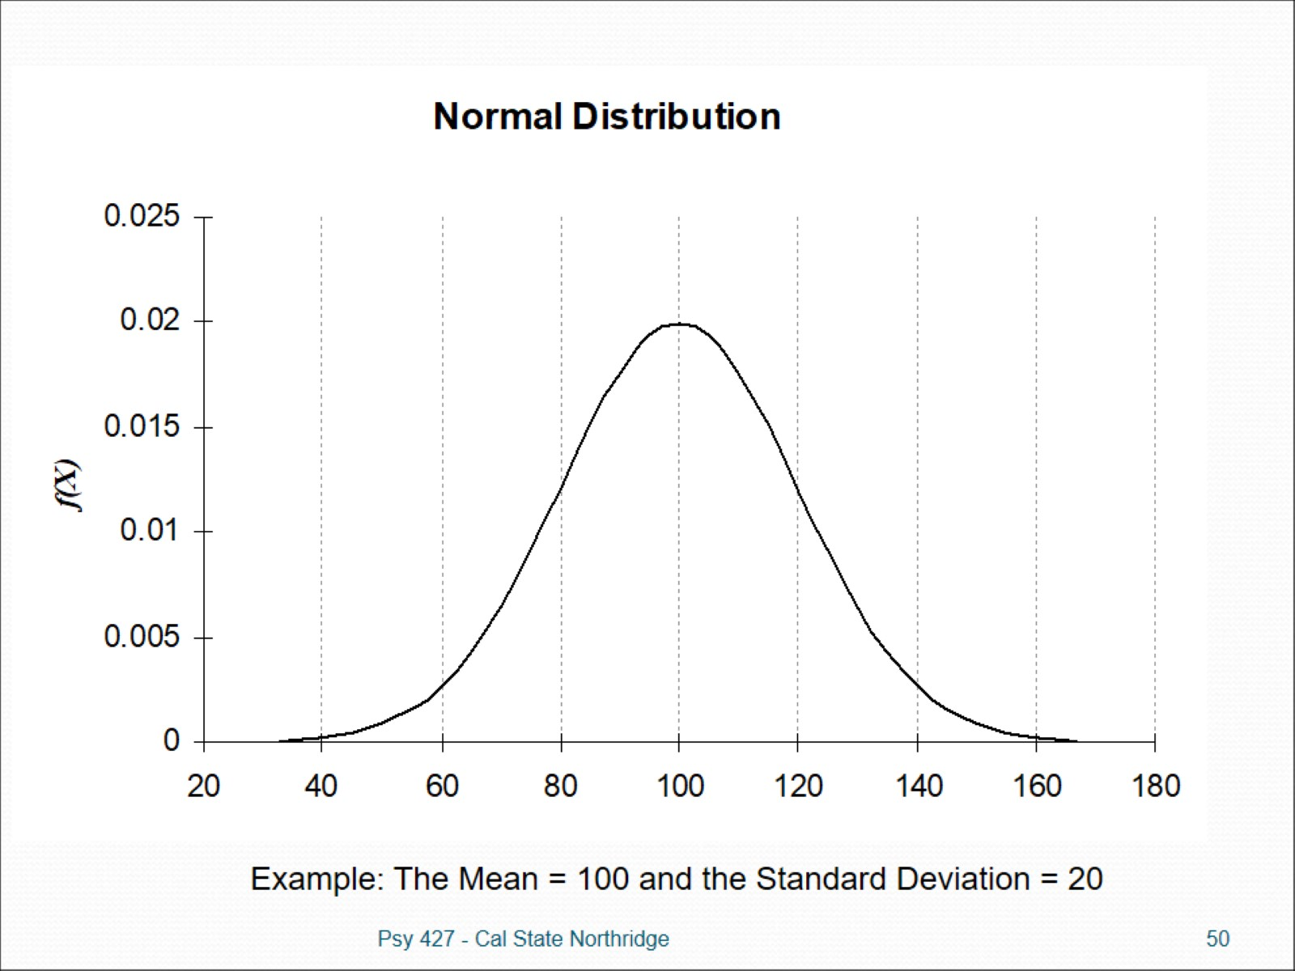

Slide 51

Normal Distribution (Characteristics)

Slide 52

Normal Distribution (Characteristics)

Slide 53


Slide 54

The standard normal distribution

Slide 55

Z-Score Formula

Slide 56

Properties of Z-Scores

Slide 57

Properties of Z-Scores

Slide 58

The standard normal distribution

Slide 59

Have→Need Chart When rough estimating isn’t enough

Slide 60

What about negative Z values?

Slide 61

Norms and Norm-Referenced Tests

Slide 62

Norms and Norm-Referenced Tests

Slide 63

Criterion-Referenced Tests

